Slide 1
Supporting Equitable Classroom Practices Through Alternate Assessment
@DavidFrangiosa
Pascack Hills HS
Montvale, NJ

Slide 2
Session Goals
We will share how we implemented current educational research to create a learning environment that supports learners of all abilities.
Takeaways
Understand the educational research supporting a shift away from traditional grading
Describe which attributes of a learning progression model address each of several major classroom issues that impact learning, including equity, differentiation, peer interactions, and growth mindset
Describe methods of implementing the research in the classroom.

Slide 3
If you leave with nothing else, take this with you.
Be Mindful How You Speak About/With Students
There are no “A students”
There are no “D students”
There are no “honors students”
There are no “special ed students”
How we talk about students frames how we think about students, which impacts how we treat students.

Slide 4
What is Equity?

Slide 5
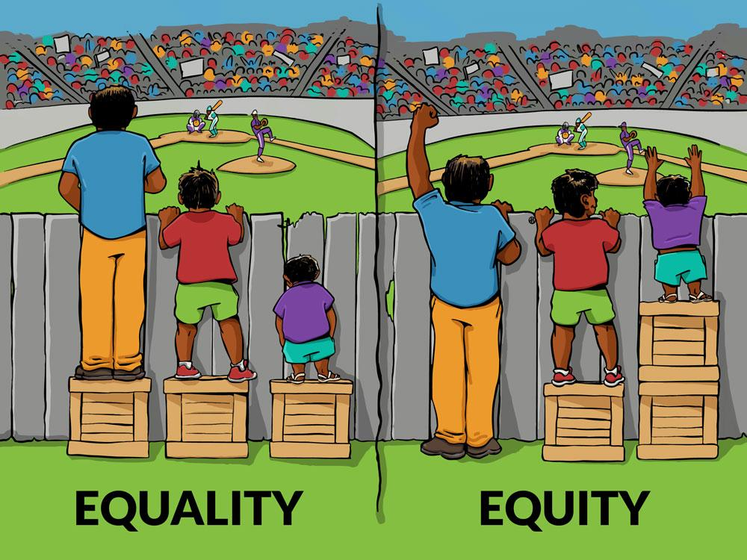
What is Equity?
Images from https://culturalorganizing.org/the-problem-with-that-equity-vs-equality-graphic/

Slide 6
What is Equity?
Images from https://culturalorganizing.org/the-problem-with-that-equity-vs-equality-graphic/

Slide 7
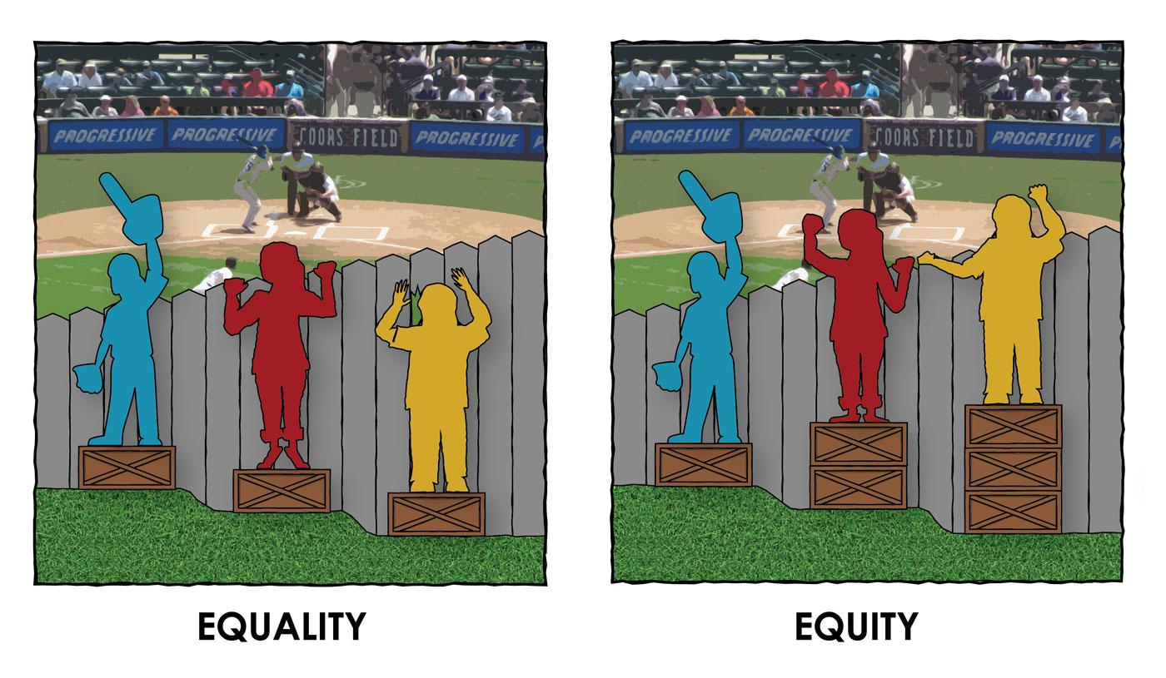
What is Equity?
Images from https://culturalorganizing.org/the-problem-with-that-equity-vs-equality-graphic/

Slide 8
A few resources that guide our thinking
Emotions, Learning and the Brain - Mary Helen Immordino-Yang
Culturally Responsive Teaching and the Brain - Zaretta Hammond
Enhancing and Undermining Intrinsic Motivation - Ruth Butler
Bloom’s Taxonomy - Benjamin Bloom
Cognitive Load Theory - John Sweller

Slide 9
Challenges Students Face
Challenges for high achieving students
Assume they should know this
Little room for creativity
High pressure environment deters risk-taking
Challenges for students who have not performed well in school
Watered down curriculum
Limited exposure to challenging concepts
Compliance focused classrooms

Slide 10
Finding Appropriate Challenge
Shift our view of differentiation
Move from differentiated opportunity to differentiated support
Have clearly defined and communicated outcomes (Use student-friendly language)
Provide multiple practice opportunities
Avoid judgment

Slide 11
Assessing vs Grading
Assessment - an evaluation of where a student is in their learning progression
Grading - scoring/judging student progress against a predetermined scale

Slide 12
Qualities of an Equitable Assessment
Aligned with clearly stated learning outcomes
Representative of the learning
All students can engage with the assessment
Provides immediate, descriptive feedback (or as close to immediate as possible)
Allows additional opportunities to show growth

Slide 13
Aligned with Clearly Stated Outcomes
Make explicit what students need to know and do
Detail the level to which they need to display these concepts

Slide 14
Aligned with Clearly Stated Outcomes
Image from Going Gradeless: Shifting Student Focus to Learning, Corwin Publishing

Slide 15
Aligned with Clearly Stated Outcomes
Image from Going Gradeless: Shifting Student Focus to Learning, Corwin Publishing

Slide 16
Aligned with Clearly Stated Outcomes
Make explicit what students need to know and do
Detail the level to which they need to display these concepts
Outcomes are a guideline not a road map

Slide 17
Representative of the Learning
Assessments should reflect material that has been taught and practiced
Assessment questions and activities are framed similarly to practice
Scores do not include non-academic factors (neatness, late penalties, etc.)
*This does not mean sacrifice accountability

Slide 18
All Students Can Engage with the Assessment
Low floor/High ceiling
Any student can engage with the assessment
Students with a more sophisticated understanding can elaborate on their answer

Slide 19
All Students Can Engage with the Assessment
Sample Assessment Question: Air bags are used in cars as a safety feature to protect front-seat passengers. How does this safety feature help to protect the passengers of the car?
Notes:
Developing

Slide 20
All Students Can Engage with the Assessment
Sample Assessment Question: Air bags are used in cars as a safety feature to protect front-seat passengers. How does this safety feature help to protect the passengers of the car?
Notes:
Developing

Slide 21
Sample Assessment Question: Air bags are used in cars as a safety feature to protect front-seat passengers. How does this safety feature helps to protect the passengers of the car?
Student Response #1: Airbags help protect the passengers of the car by increasing the time of the impulse and decreasing the amount of force. Although the airbag does not change the amount of impulse required to stop a passenger, it changes how the impulse is put on the driver. The change in momentum does not change with or without the airbag. Increasing the time makes the same impulse have less force. The reason for this is that when the impulse is spread out over a longer duration the force is not as strong.
Notes:
Developing

Slide 22
Sample Assessment Question: Air bags are used in cars as a safety feature to protect front-seat passengers. How does this safety feature helps to protect the passengers of the car?
Student Response #2: First of all, airbags in cars are used to protect your body from the impact of a collision. It reduces the force of the front of the car hitting the passenger. In this collision, airbags are used to stop the momentum of the passengers in the car. Because the car is initially moving at some speed, if the car comes to a stop without any warning, any object in the car keep moving at that speed and hit unexpectedly. Ultimately, the airbags add additional time needed for stopping the momentum of the passengers. These clearly explains how impulse acted on an object is equal to the change in momentum. F∆t = m ∆v. Each of these terms have to be directly proportional to each other.
Notes:
Advanced

Slide 23
Sample Assessment Question: Air bags are used in cars as a safety feature to protect front-seat passengers. How does this safety feature helps to protect the passengers of the car?
Student Response #3: This protects people in the car because it keeps them in place and does not let them move. When driving in a car, your body has a lot of momentum and when you crash, that would make you go flying out the windshield or into another passenger. The air bag prevents your body from going anywhere, in other words, making your momentum 0.
Notes:
Beginning

Slide 24
All Students Can Engage with the Assessment
Sample Assessment Question: A 60 kg bicyclist (including bike) is biking along a horizontal road with an initial speed of 12 m/s. He stops pedaling, decreasing speed until he stops 15 m later. What is the coefficient of friction of the pathway on the bicycle?
Notes:
Developing

Slide 25
Sample Assessment Question: A 60 kg bicyclist (including bike) is biking along a horizontal road with an initial speed of 12 m/s. He stops pedaling, decreasing speed until he stops 15 m later. What is the coefficient of friction of the pathway on the bicycle?
Student Response #1:
Notes:
Developing

Slide 26
Sample Assessment Question: A 60 kg bicyclist (including bike) is biking along a horizontal road with an initial speed of 12 m/s. He stops pedaling, decreasing speed until he stops 15 m later. What is the coefficient of friction of the pathway on the bicycle?
Student Response #2:
Notes:
Proficient

Slide 27
Sample Assessment Question: A 60 kg bicyclist (including bike) is biking along a horizontal road with an initial speed of 12 m/s. He stops pedaling, decreasing speed until he stops 15 m later. What is the coefficient of friction of the pathway on the bicycle?
Student Response #3:
Notes:
Advanced

Slide 28
Provide Immediate Descriptive Feedback
Evaluative vs descriptive feedback

Slide 29
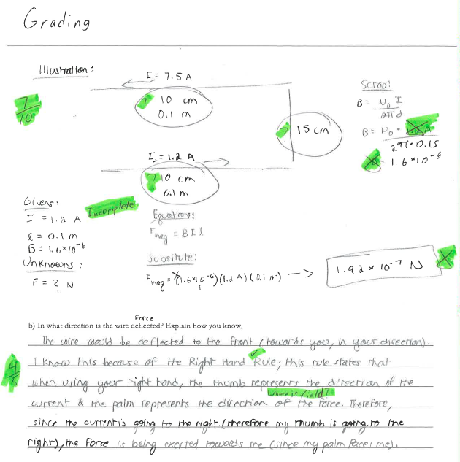
This is Evaluative Feedback

Slide 30
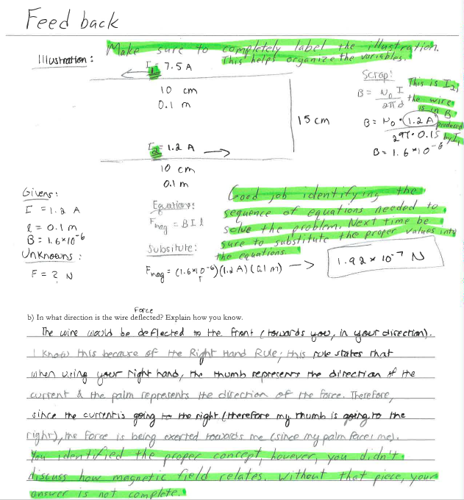
This is Descriptive Feedback

Slide 31
Provide Immediate Descriptive Feedback
Evaluative vs descriptive feedback
Provide descriptive feedback before students do additional practice

Slide 32
Descriptive Feedback to grow and improve
Evaluative vs descriptive feedback
Provide descriptive feedback before students do additional practice
Notes:
Beginning

Slide 33
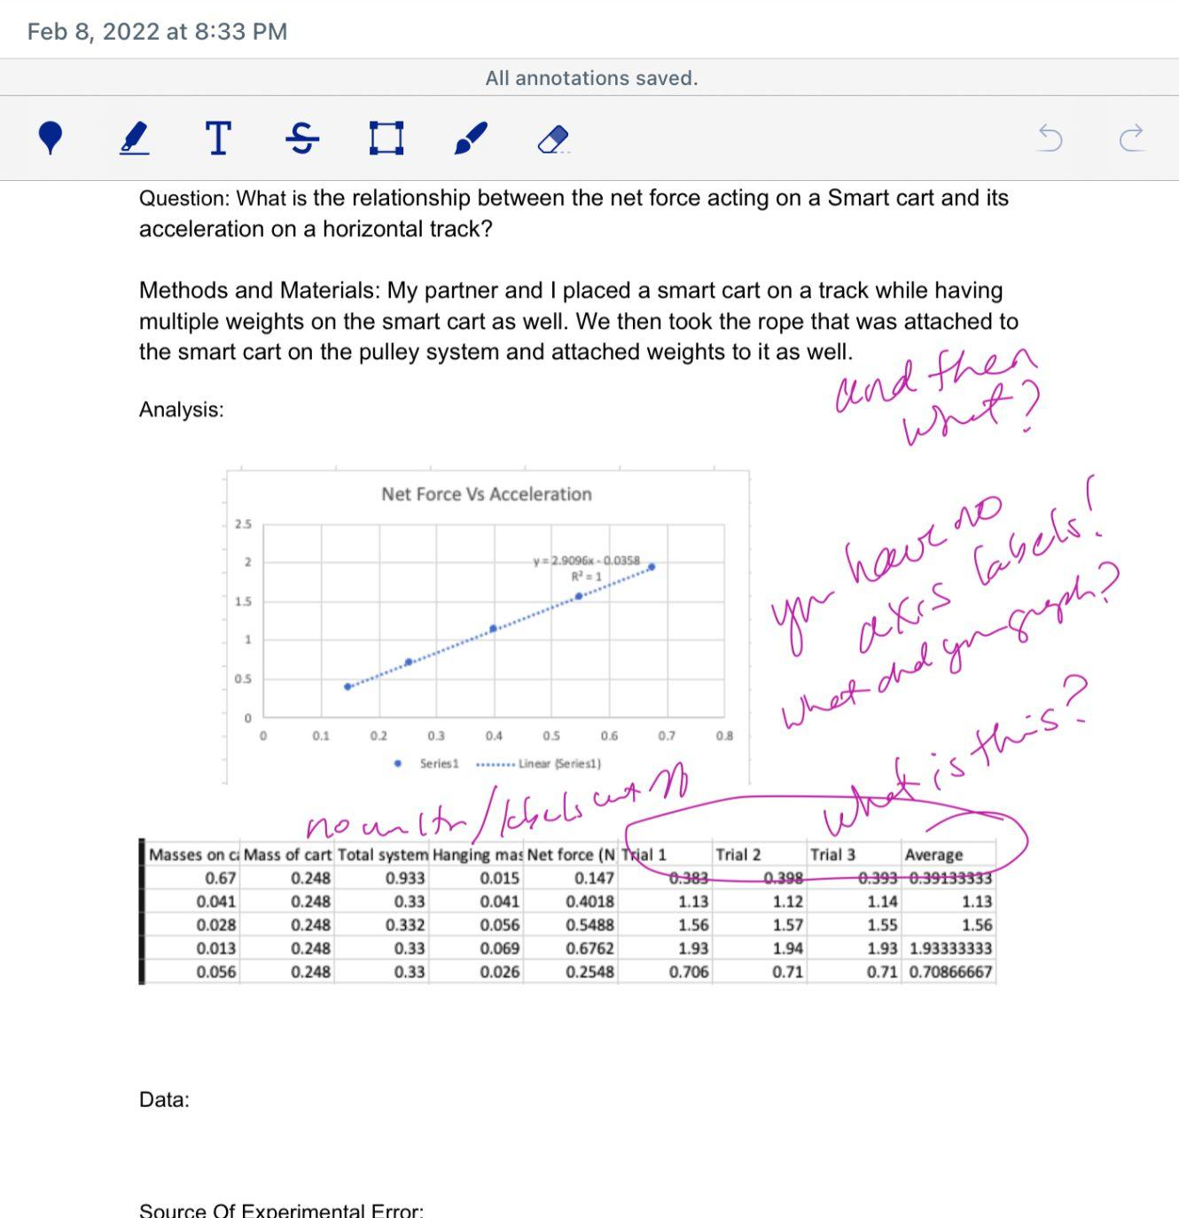
Descriptive Feedback to grow and improve
Evaluative vs descriptive feedback
Provide descriptive feedback before students do additional practice
Notes:
Developing

Slide 34
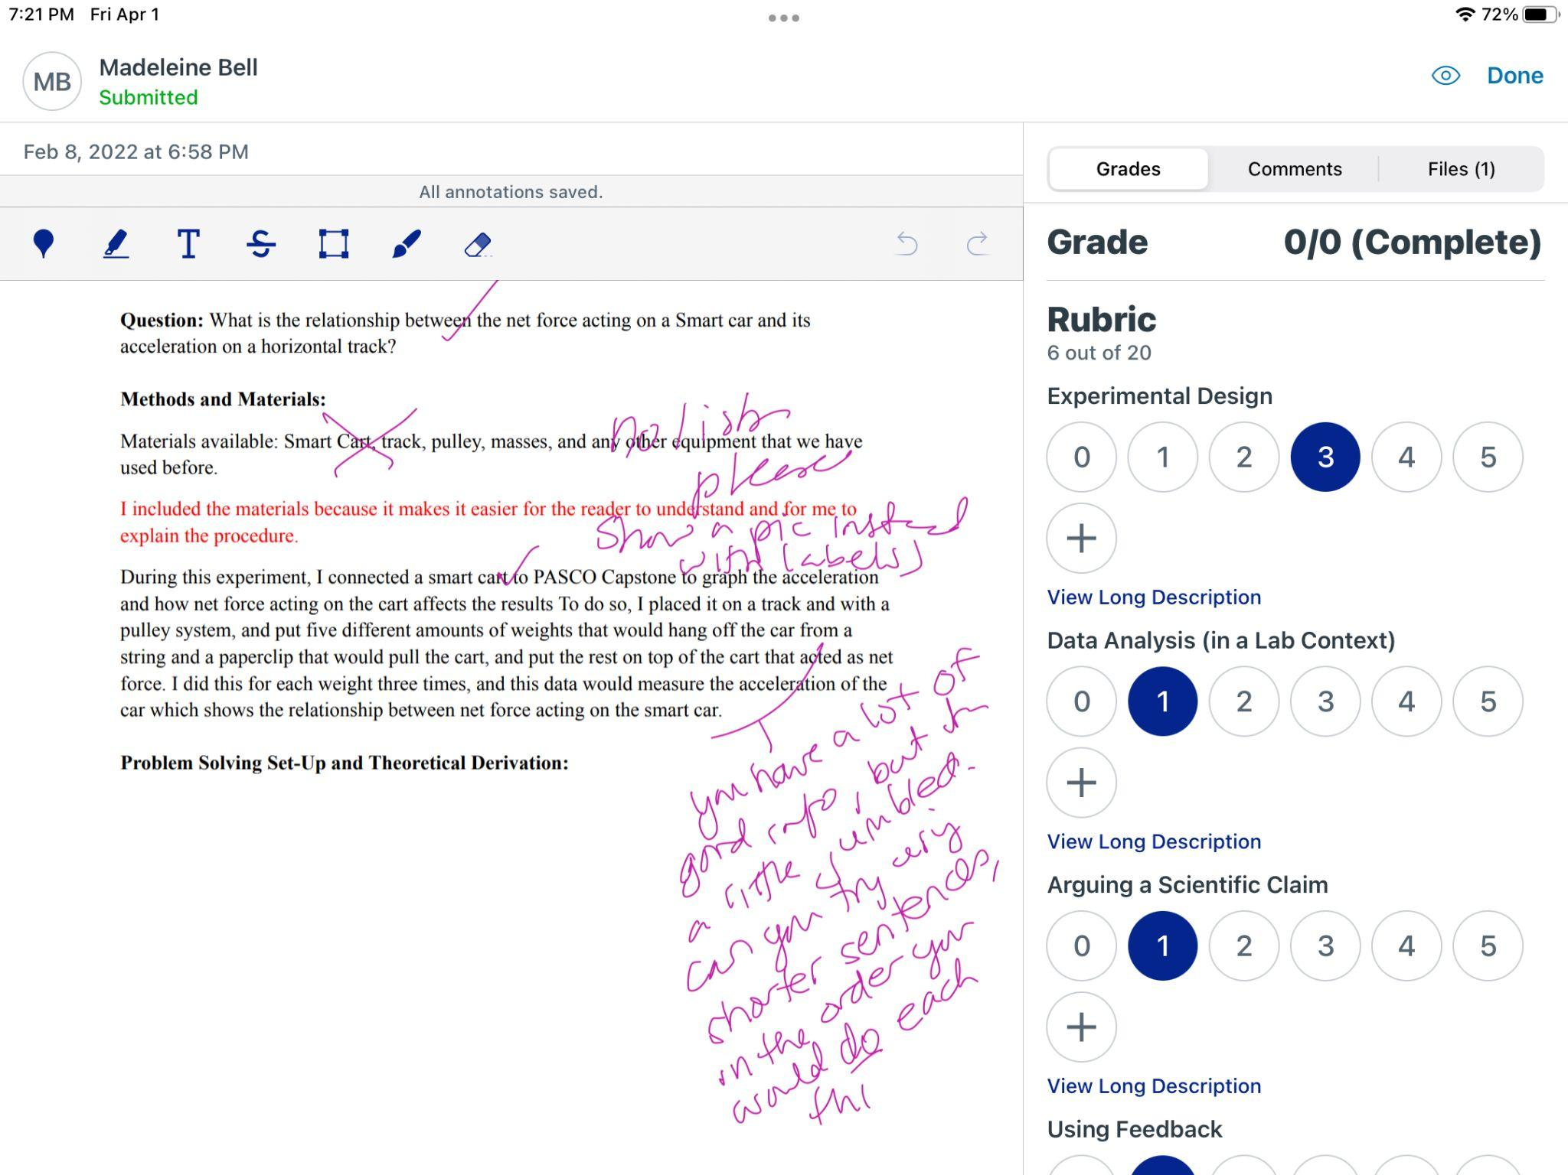
Descriptive Feedback to grow and improve
Evaluative vs descriptive feedback
Provide descriptive feedback before students do additional practice
Notes:
Proficient

Slide 35
Provide Immediate Descriptive Feedback
Evaluative vs descriptive feedback
Provide descriptive feedback before students do additional practice
Strategies for reducing the burden of feedback
Whole class feedback
Worked examples (live or recorded)
Peer reviews
Informal conferencing
Checkpoints
Collaborative Learning System

Slide 36
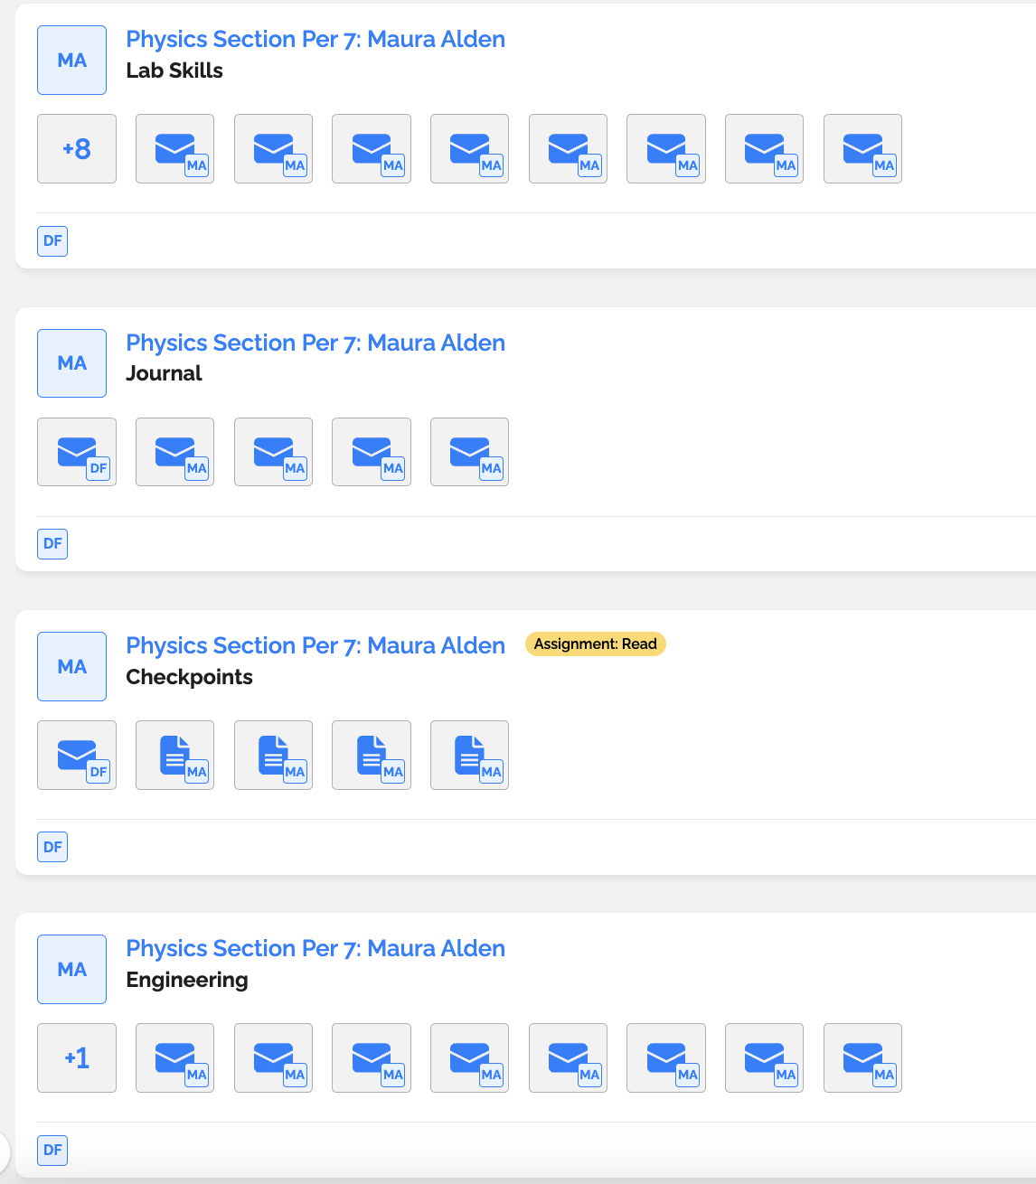
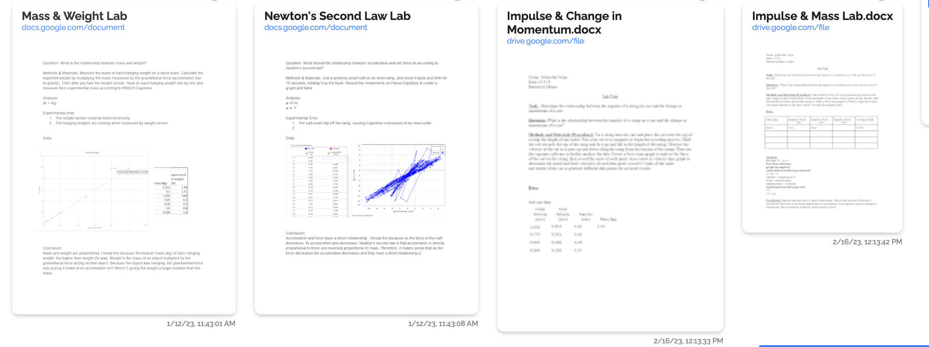
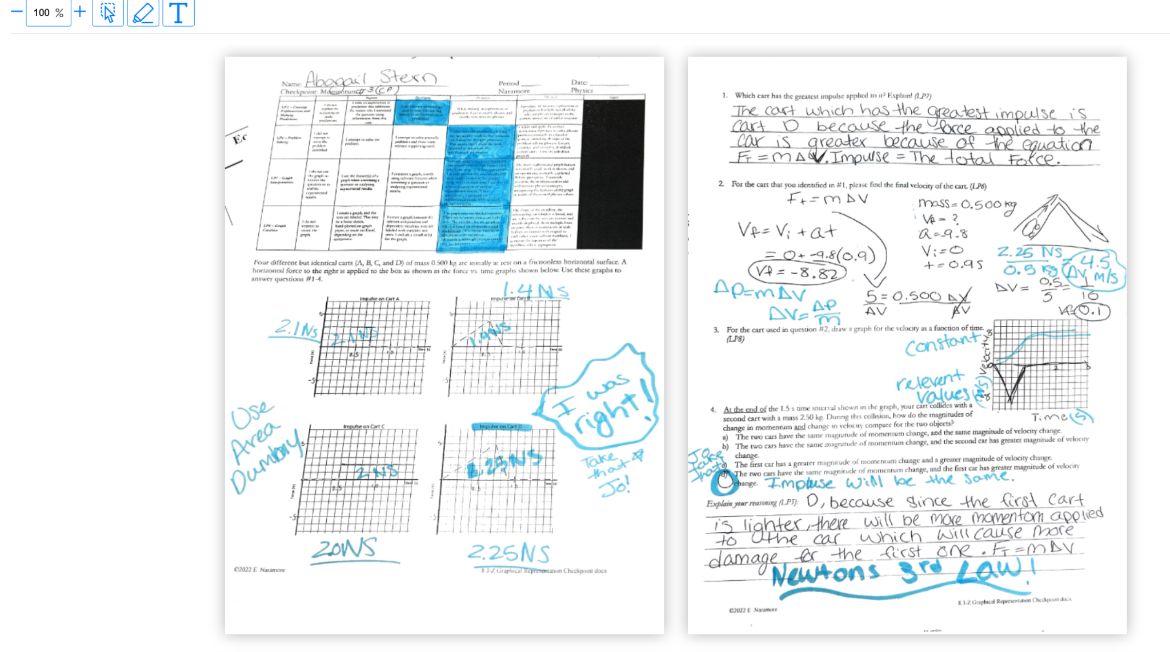
gotLearning

Slide 37
Our Mission Statement
The Learning Progression Model is an approach to teaching and learning that de-emphasizes the role of grades, provides access to learners of all abilities, and shifts the focus back to the acquisition of knowledge and transferable skills. This is accomplished through a research-backed, strengths-based approach that is designed to identify and communicate concrete and measurable progress towards these goals.

Slide 38
Contact Us
@DavidFrangiosa
dfrangiosa@pascack.org
Link to our website with more information

