Slide 1
Ditch Grades Not Accountability
@DavidFrangiosa
Pascack Hills HS
Montvale, NJ

Slide 2
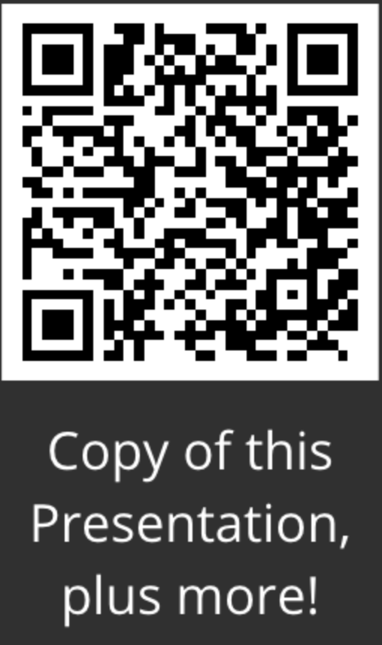
Ditch Grades Not Accountability
@DavidFrangiosa
Pascack Hills HS
Montvale, NJ

Slide 3
A Few Questions Before We Begin
What brought you here today?
What is the purpose of school?
How do grades help serve that purpose?

Slide 4
My Goals in the Classroom
Student engagement
Instilling a desire to learn
Acquisition of knowledge and skills
Application of knowledge and skills to new situations
Moving towards independence

Slide 5
What “Ditching Grades” Means
Remove judgment from the learning process
Provide descriptive feedback
Coach students to their next developmental level
Alternatives to traditional grading
Delayed grading
Conferencing/Co-constructing grades
Mastery Transcript

Slide 6
The Myths of Grades
Similar work will be assessed similarly
Grades communicate student ability

Slide 7
Date of Assignment | Student A
September | 90
October | 90
November | 80
December | 80
January | 70
February | 70
March | 70
April | 60
May | 60
June | 60

Slide 8
Date of Assignment | Student A | Student B
September | 90 | 60
October | 90 | 60
November | 80 | 60
December | 80 | 70
January | 70 | 70
February | 70 | 70
March | 70 | 80
April | 60 | 80
May | 60 | 90
June | 60 | 90

Slide 9
Date of Assignment | Student A | Student B
September | 90 | 60
October | 90 | 60
November | 80 | 60
December | 80 | 70
January | 70 | 70
February | 70 | 70
March | 70 | 80
April | 60 | 80
May | 60 | 90
June | 60 | 90
Average | 73 | 73

Slide 10
The Myths of Grades
Similar work will be assessed similarly
Grades communicate student ability
Grades motivate students

Slide 11
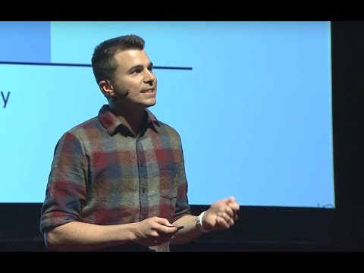

Slide 12
Clearly Defined Targets
Try - Students try to complete the assigned task.
Explain - Students use relevant content knowledge to try to address the task. (The content knowledge does not have to be correct, but it must be reasonable.)
Explicit - Students explicitly and accurately state a relevant big idea, equation, law, etc., but the application is incorrect or incomplete.
Correct - Students explicitly and accurately state a relevant big idea, equation, law, etc. and apply it correctly and completely.
Complete/Complex - Students explicitly and accurately address a complex task that includes multiple steps or concepts.

Slide 13
Aligning the Practices with Progressions
Learning Progressions | NGSS Practices
Experimental Design | Asking questions and defining problems
Problem Solving | Developing and using models
Data Analysis | Planning and carrying out investigations
Arguing a Scientific Claim | Analyzing and interpreting data
The Engineering Design Process | Using mathematics and computational thinking
Using and Providing Feedback | Constructing explanations and Designing solutions
Graph Interpretation | Engaging in Argument from Evidence
Graph Creation | Obtaining, evaluating, and communicating information
Creating Explanations and Making Predictions

Slide 14
Example of a Learning Progression
 | Not Enough Evidence | Beginning | Developing | Proficient | Advanced | Expert
Arguing a Scientific Claim | I did not write a conclusion. | I write a conclusion. | I present a scientific claim regarding the relationship between relevant dependent and independent variables. I present evidence obtained from my investigations as support. | I present a scientific claim that accurately describes the relationship derived from my experimental results. I present convincing evidence. I state a physics concept, theory, or equation as reasoning. | I present the most convincing, valid and reliable evidence obtained from my investigations as support for my claim. I clearly state a relevant physics concept, theory, or equation as reasoning. The reasoning is clearly related to the variables in the claim. There is no extra/irrelevant information. | I effectively tie physics theory correctly, directly, and tightly to the most sophisticated supporting evidence available, so that my claim is clearly justified. I justify my claim by providing quantitative proof that the results reflect the theory.

Slide 15
Goal Setting
Done at the beginning of the year
Grade goal
Non-grade learning goal (a skill or habit they would like help developing)
3 things they are willing to do to meet these goals
Revisited at the beginning of each unit
Discussed during conferencing

Slide 16
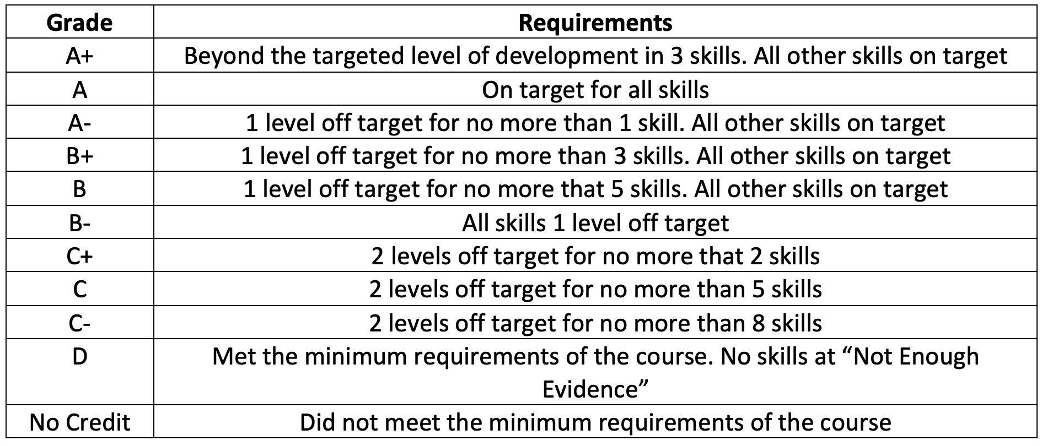
Grade Translation

Slide 17
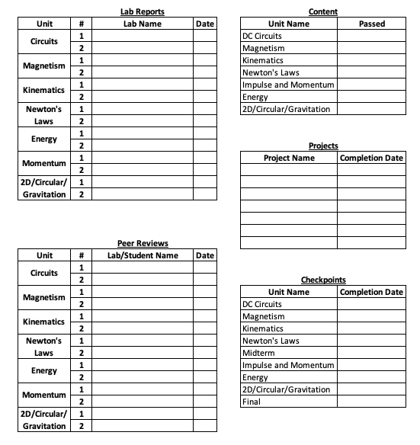
Establishing Minimum Requirements

Slide 18
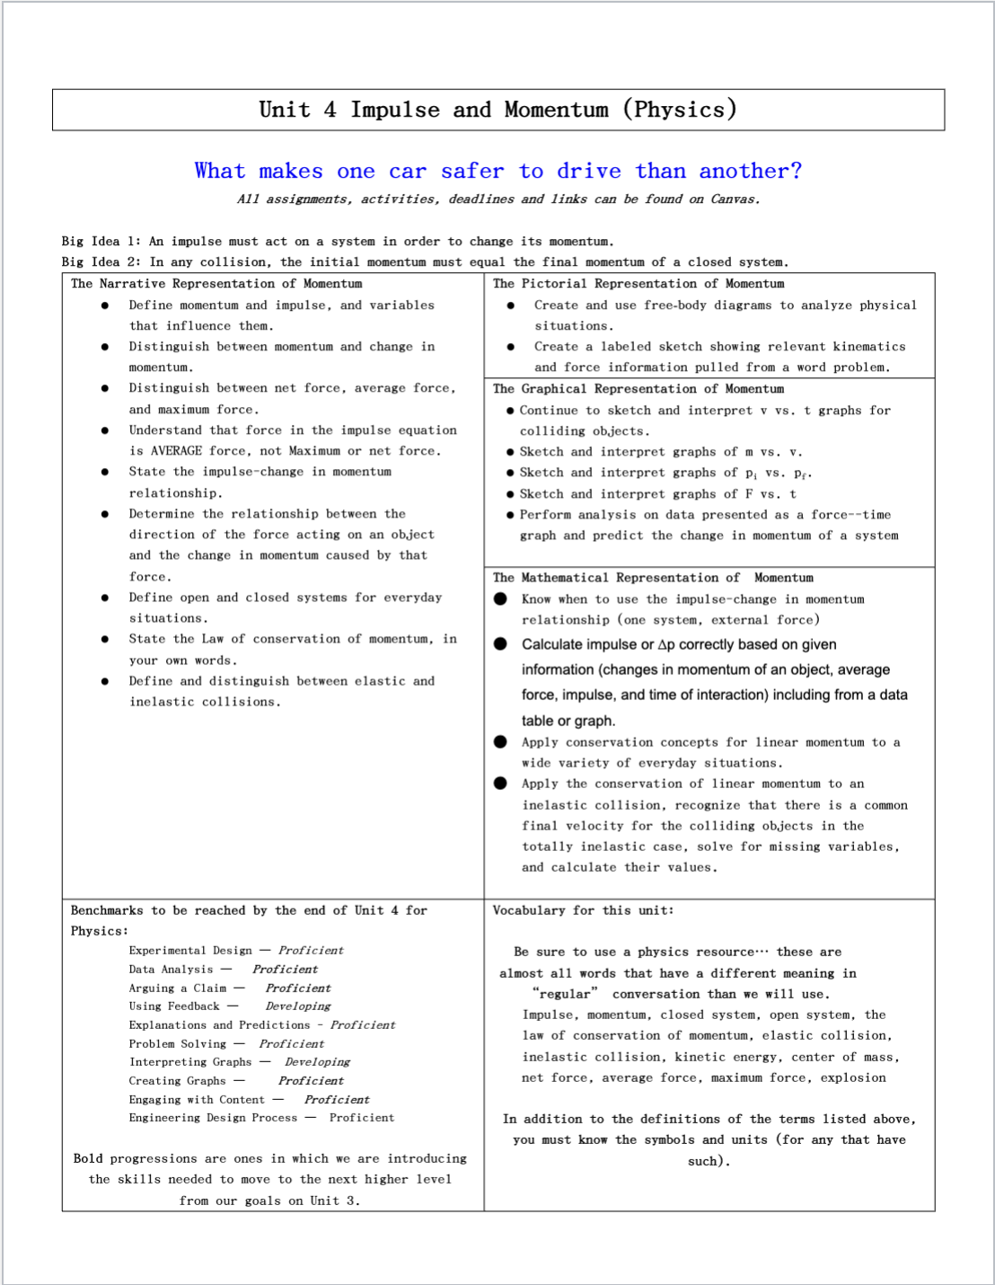
Tracking Progress

Slide 19
Reassess vs Redo/Retake
Redo/Retake - additional attempts at the same or similar assessment
Appropriate for foundational concepts, pass/fail assessments
Low Intrinsic Load
Initial development of schema
Should not be included in grade translation
Reassessment - ongoing evaluation of processes or skills
Current level of progress of recurring skills
Used to provide actionable feedback
Skills that will be translated to a grade

Slide 20
Document Progress
Weekly Checkpoints
Multiple Lab Opportunities
Unit Projects
Journaling
Conferencing (mini and formal)

Slide 21
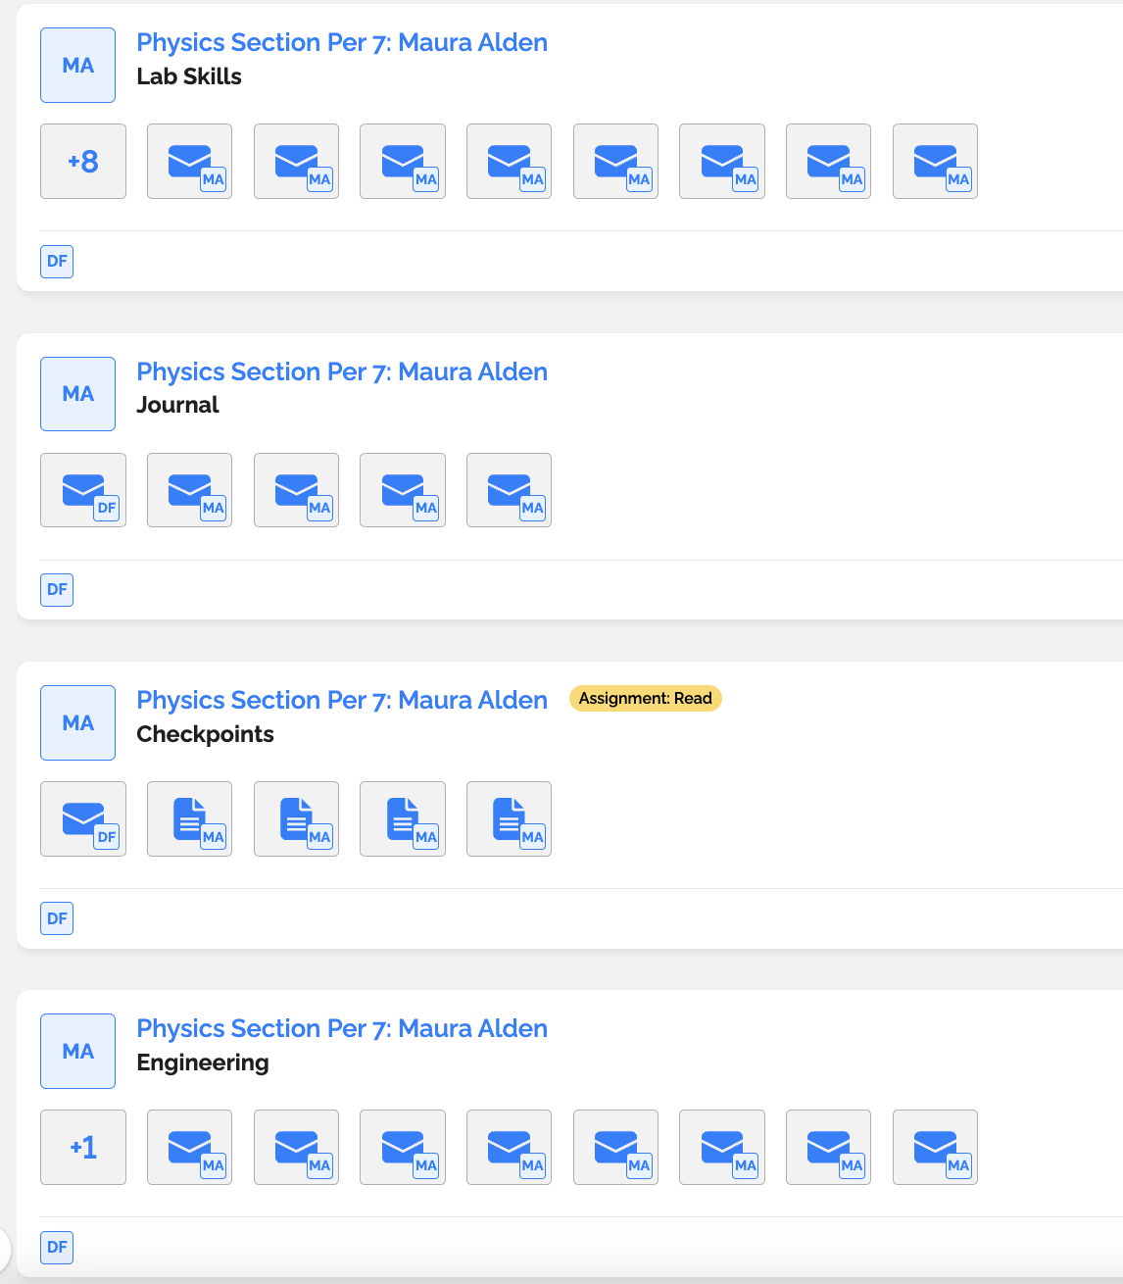
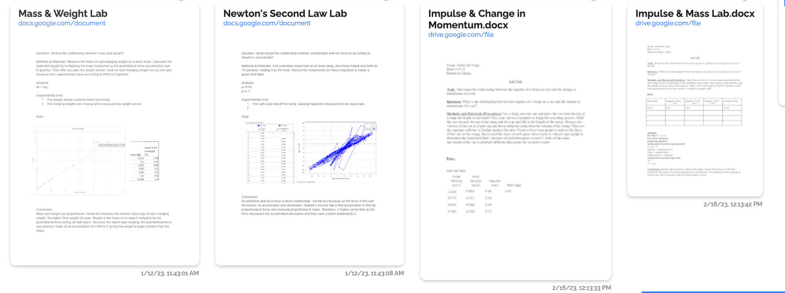
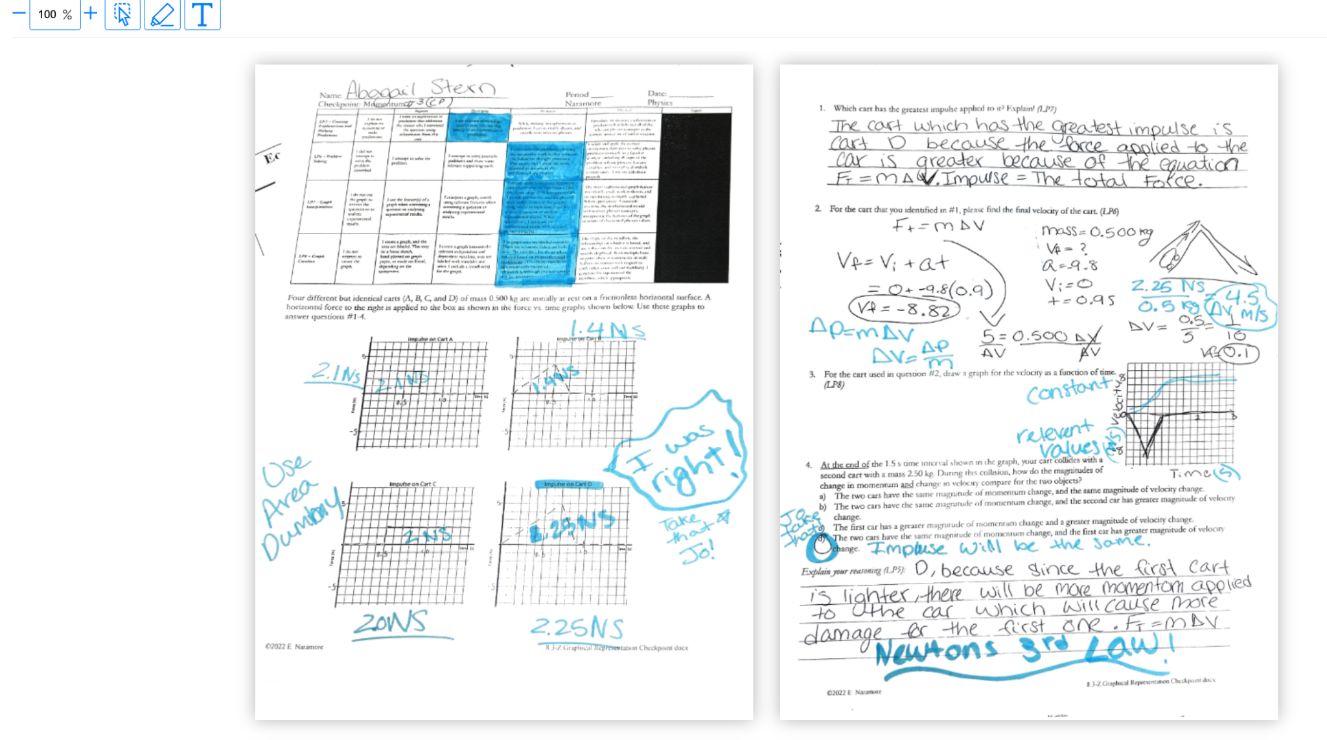
gotLearning

Slide 22
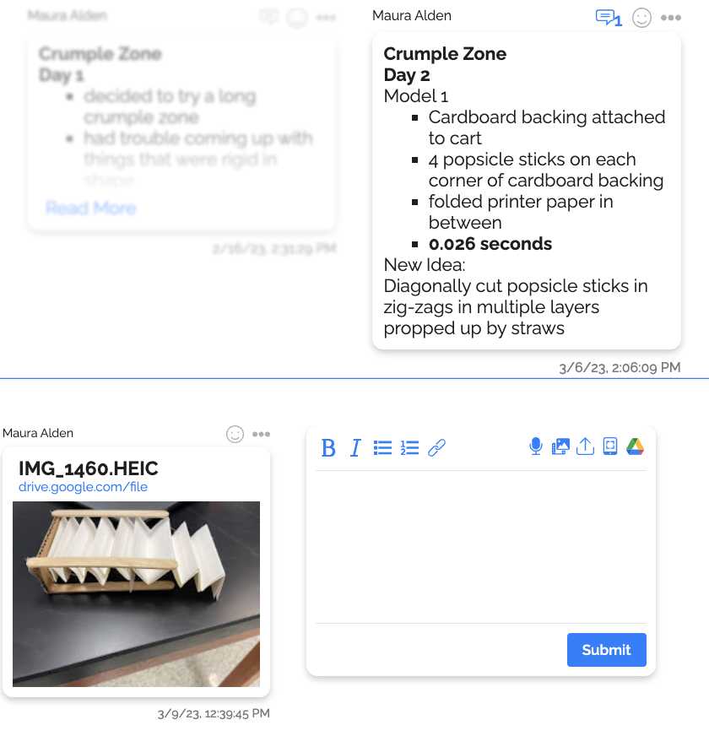
gotLearning

Slide 23
Feedback
Evaluative
Letter grades
Numbers
General terms “Good Job”, “Needs Improvement” etc
Checkmarks
Descriptive
Specific, individualized feedback that explicitly describes to a student how to improve their work
Coaches students through the learning process

Slide 24
Ongoing Conversations and Conferencing
Informal conversations during independent practice
Get to know students
Understand strengths and areas for growth
Provide individualized feedback
Formal Conferences
Student led
3-4 times per year
Reflect and goals and progress
Provide individualized next steps
Determine minimum course grade

Slide 25
Triggering Interventions
Any skill that is 2 levels off target becomes an area of focus
If areas of focus are not addressed, it triggers an intervention
Can happen much earlier in the school year
The purpose of the intervention is to stimulate learning and growth

Slide 26
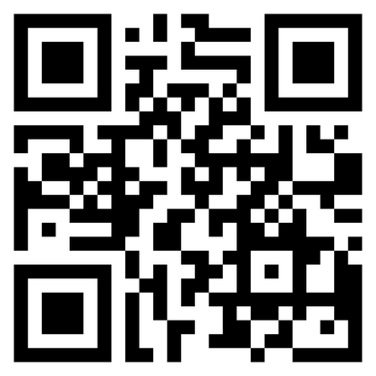
Contact Us
@DavidFrangiosa
dfrangiosa@pascack.org
Link to our website with more information

