Slide 1
Assessment 3.0
Introducing The Learning Progression Model
Presented by Elise Naramore
Pascack Hills High School
© 2023 by Elise Naramore
Notes:
I have been an educator for a long time. Yet somehow, I never thought I’d be the veteran teacher around my school. And I certainly didn’t imagine that I’d still be eager, striving, and trying to figure it out! For sure, after 30-odd years, I will have nailed it! Every student walking into my room on September 1st ignorant will walk out in June enlightened and educated.
Yeah, well, unfortunately, that’s not how it works! Teenagers have their own baggage. As do school systems, mired in tradition and institutional inertia. So here I am, when many of my colleagues are thinking about retirement, working on the next phase of better-than-what-I-was doing. If you are here, I assume you are seeking the same thing: how to make better humans during the short time you have with them.

Slide 2
Today’s Presentation
Introduction
A Brief History
The Learning Progression Model
Implementation
Four Things You Can Start Tomorrow
Copy of this Presentation, plus more!
© 2023 by Elise Naramore
Notes:
1. Distinguish between evaluative and descriptive feedback.
2. Understand the research that grounds this approach.
3. Develop of rationale for practicing the skill of “Using Feedback”
4. View and edit a possible rubric to use to score “Using Feedback”
5. Examine several examples of student work, and score them using the rubric.

Slide 3
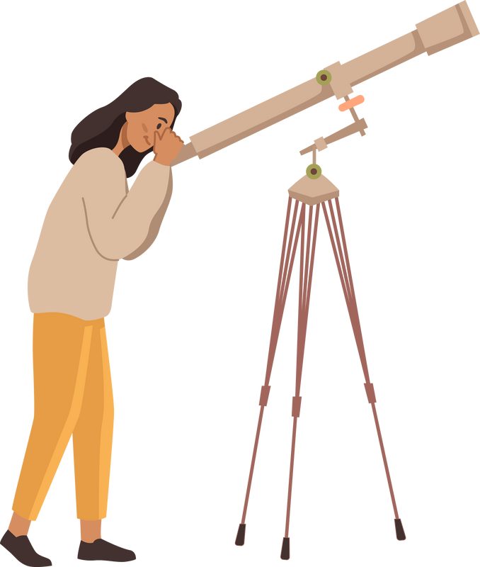
What brought you here today?

Slide 6
"Learning is not the product of teaching. Learning is the product of the activity of learners."
John Holt, 1983
© 2023 by Elise Naramore
Notes:
Let me start by telling you a story. Ms. Burns was a dedicated science teacher who spent hours grading her students’ work. She wanted to make sure her students understood what they did well and what they needed to improve. She wrote detailed comments, providing specific examples and suggestions for improvement. But as she handed back the papers, she noticed that her students seemed to be more interested in their grades than in her comments. They quickly glanced at the comments and then put the papers away. The next time they had to do a similar assignment, she found herself writing the same comments all over again. Despite her efforts, there was little improvement in their writing.
That was me for most of my career! Can you relate to that? I distinctly remember when I decided to no longer bother writing any comments. I began to just write “-2”, “good”, and other terse evaluations. I figured, “Why bother? They don’t read them anyway. The students who want more information can come to me to talk!” Well, that didn’t work either.
Fast forward to 4 years ago, when I had already made the switch to LPM. I found that students were stuck at the developing levels because even without a grade, they were reading but not using my detailed, descriptive feedback. Feedback is most effective when it is timely, specific, and actionable (Hattie & Timperley, 2007). However, simply providing feedback is simply not enough to ensure that students use it to improve their performance. To encourage students to use feedback, it is important to provide opportunities for them to reflect

Slide 7
Identify where students are in their learning
What is the purpose of assessment?
Provide actionable feedback
Practice

Slide 8
mastery transcript
SBG
Traditional
learning progression model
Project-based learning
Competency-based grading
proficiency-based grading

Slide 9
Why "Assessment 3.0"?
1.0
2.0
3.0
Traditional Grading
Standards-Based Grading
Learning Progession Model
Notes:
significant problems: grades, inherent bias, overwhelming workload on the teacher, and confusion about goals (a lack of transparency).

Slide 10
Standards-Based Grading
Learning Progression Model
Content-specific skills Focus
Universal Practices Focus
Product Focus
Process Focus
Removes non-academics from grading
Proficiency scales judge performance
Target Levels identify appropriate next steps
Clearly Defined Outcomes
Limited number of skills
Student needs
Teacher Wants
Specific feedback on progress
Scales describe how well they complete a given task
Detailed LPs - developmental
Flexible grade translation
Allows multiple attempts
Reassessment
Retakes
Ungraded formative assessment
Descriptive Scoring
Quantitative Scoring (usually 1 - 4)
Unfamiliar and novel
Content Agnostic
Each skill as a separate standard

Slide 11
What is the Learning Progression Model?
A flexible framework designed to recenter learning and meet students at their developmentally-appropriate level.

Slide 12
Learning Progressions
Target Levels
What are the essential components of LPM?
Assessments
Ample practice and feedback
Method of Reporting Progress
Reflective Practices

Slide 13
"The practices are what students DO to make sense of phenomena. They are both a set of skills and a set of knowledge to be internalized. The SEPs reflect the major practices that scientists and engineers use to investigate the world and design and build systems."
NGSS, 2013
the practices

Slide 14
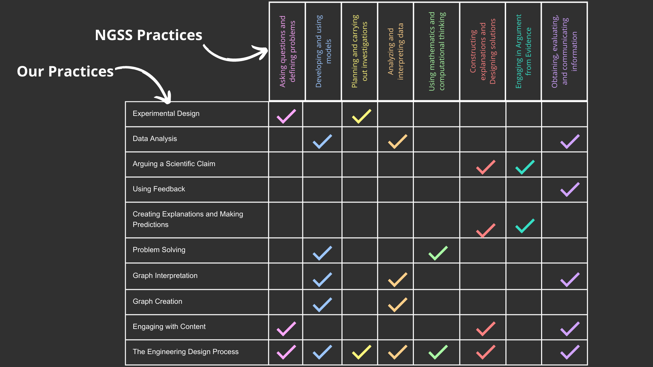

Slide 15
Breakdown of a practice
Proficiency levels
Descriptive feedback
Used all year long
General
Tracking progress
the learning progression
Notes:
A learning progression is created when you break down a practice into developmentally-sequenced levels of proficiency. Instead of deducting points for what students cannot do correctly, you assess what students know or can do, giving feedback based on specific language presented in a rubric.
One of my favorite things about learning progressions is that they are used all year long. They are general enough to apply to categories of assessments, so I don’t need to create a new rubric for each assignment. This feature enables me to track student growth over time, and they can target what they need to do to improve their performance on that type of assessment.

Slide 16
EXPERT
Achievement Levels
Not Enough Evidence
Beginning = Try
Developing = Relevant
Proficient = Explicit
Advanced = Accurate
Expert = Complex
ADVANCED
PROFICIENT
DEVELOPING
BEGINNING
NOT ENOUGH EVIDENCE
Notes:
The Ladder:
"Low Floor ->High Ceiling"
Requires external support
non-uniform
incremental building
sequential

Slide 17
“To be useful, feedback must be consistent. Clearly, performers can only adjust their performance successfully if the information fed back to them is stable, accurate, and trustworthy. In education, that means teachers have to be on the same page about what high-quality work is.”
Grant Wiggins, 2012

Slide 18
Learning Progression
"Creating Scientific Explanations"
Break down the process of creating scientific explanations into specific levels to provide a clear roadmap for improving their performance over time.
The goal is to show what physics they know and can apply from the current unit of study.
© 2023 by Elise Naramore
Notes:
3. Develop of rationale for practicing the skill of “Using Feedback”
Feedback section is where students annotate their lab report, highlighting the changes they made from their previous lab report. The goal is to communicate what changes they made, why they made them, and how they have improved over time.
A learning progression provides students with clear expectations for what they are expected to learn and how they can demonstrate their understanding of the material (Wilson & Draney, 2015). If this is the first visit to my writing, I have an earlier blog post about developing Learning Progressions in general as well as a PD course if you prefer video. By breaking down the process of using feedback into specific levels, students are provided with a clear roadmap for how they can improve their performance over time. I ask students to identify changes that they made in response to feedback, and to explain why those changes were necessary. Self-reflection is a critical component of effective feedback use (Butler & Winne, 1995). Students engage in a process of self-reflection that can help to deepen their understanding of the material.

Slide 19
"Creating Scientific Explanations"
Not Enough Evidence | Beginning | Developing
I do not answer the question and/or I do not explain my reasoning or make predictions. | I answer the question and I write an explanation or prediction that addresses the reason why I answered the question. | I use relevant terminology and/or state relevant Big Idea(s) in my explanation or prediction, using information from this unit.
Proficient | Advanced | Expert
While making an explanation or prediction, I can correctly choose and overtly state relevant physics. | I produce an accurate explanation or prediction that fully ties all of the relevant physics concepts to the correct answer, in a familiar situation. | I produce an accurate explanation or prediction for a complex situation. This may require the use of multiple steps and/or multiple Big Ideas, applying previously learned material when necessary.
© 2023 by Elise Naramore
Notes:
3. Develop of rationale for practicing the skill of “Using Feedback”
Feedback section is where students annotate their lab report, highlighting the changes they made from their previous lab report. The goal is to communicate what changes they made, why they made them, and how they have improved over time.
A learning progression provides students with clear expectations for what they are expected to learn and how they can demonstrate their understanding of the material (Wilson & Draney, 2015). If this is the first visit to my writing, I have an earlier blog post about developing Learning Progressions in general as well as a PD course if you prefer video. By breaking down the process of using feedback into specific levels, students are provided with a clear roadmap for how they can improve their performance over time. I ask students to identify changes that they made in response to feedback, and to explain why those changes were necessary. Self-reflection is a critical component of effective feedback use (Butler & Winne, 1995). Students engage in a process of self-reflection that can help to deepen their understanding of the material.

Slide 20
the target levels
A Target Level is the benchmark that students are expected to reach by the end of the unit, usually identified as a specific step on the rubric.
The teacher bases the target upon current student achievement.
Based upon research about cognitive load and executive function.
As students achieve benchmark, the teacher “opens” up the next level.
Individual or whole class

Slide 21
“Organizing instruction into small steps that are developmentally appropriate can support students in the development of executive function skills, such as working memory, attention, and self-regulation”
Diamond and Lee, 2011
Notes:
These executive function skills are important for learning, and breaking down learning into small steps can help support their development.
By giving students one step at a time to master and assimilate, teachers can help reduce the cognitive load and make learning more effective.

Slide 22
"Creating Scientific Explanations"
Not Enough Evidence | Beginning | Developing | Proficient | Advanced | Expert
I do not answer the question and/or I do not explain my reasoning or make predictions. | I answer the question and I write an explanation or prediction that addresses the reason why I answered the question. | I use relevant terminology and/or state relevant Big Idea(s) in my explanation or prediction, using information from this unit. | While making an explanation or prediction, I can correctly choose and overtly state relevant physics. | I produce an accurate explanation or prediction that fully ties all of the relevant physics concepts to the correct answer, in a familiar situation. | I produce an accurate explanation or prediction for a complex situation. This may require the use of multiple steps and/or multiple Big Ideas, applying previously learned material when necessary.
© 2023 by Elise Naramore
© 2023 by Elise Naramore
Notes:
3. Develop of rationale for practicing the skill of “Using Feedback”
Feedback section is where students annotate their lab report, highlighting the changes they made from their previous lab report. The goal is to communicate what changes they made, why they made them, and how they have improved over time.
A learning progression provides students with clear expectations for what they are expected to learn and how they can demonstrate their understanding of the material (Wilson & Draney, 2015). If this is the first visit to my writing, I have an earlier blog post about developing Learning Progressions in general as well as a PD course if you prefer video. By breaking down the process of using feedback into specific levels, students are provided with a clear roadmap for how they can improve their performance over time. I ask students to identify changes that they made in response to feedback, and to explain why those changes were necessary. Self-reflection is a critical component of effective feedback use (Butler & Winne, 1995). Students engage in a process of self-reflection that can help to deepen their understanding of the material.

Slide 23
"Experimental Design"
Not Enough Evidence | Beginning | Developing | Proficient | Advanced | Expert
I did not include the task, data, and/or procedure. | I state the task.I collect and present data.I provide a description of the procedure followed. | I use the tools and equipment effectively to collect data related to the stated task and organize it into a table.I communicate the methods and materials used during the investigation. | I restate the task as a question that is directly related to the assigned task.I use the available measurement tools correctly.The data collected is complete and can be used to answer the question.The data table is well-organized.The methods and materials are descriptive enough for someone else to replicate the data collection during the experiment.I use a method to reduce experimental uncertainty, which is obvious in my data table. | I ask testable questions that are directly related to the assigned task.I can plan and implement precise and effective data collection strategies.The data table is well-constructed, including columns for analysis relevant to the lab.I communicate clearly, succinctly, and with sufficient detail, including labeled pictures.I explicitly describe a valid and effective method to reduce experimental uncertainty. | I ask an independently generated question.I independently develop an investigation that can produce data to answer that question.I independently carry out that investigation, collecting relevant data.
© 2023 by Elise Naramore
Notes:
3. Develop of rationale for practicing the skill of “Using Feedback”
Feedback section is where students annotate their lab report, highlighting the changes they made from their previous lab report. The goal is to communicate what changes they made, why they made them, and how they have improved over time.
A learning progression provides students with clear expectations for what they are expected to learn and how they can demonstrate their understanding of the material (Wilson & Draney, 2015). If this is the first visit to my writing, I have an earlier blog post about developing Learning Progressions in general as well as a PD course if you prefer video. By breaking down the process of using feedback into specific levels, students are provided with a clear roadmap for how they can improve their performance over time. I ask students to identify changes that they made in response to feedback, and to explain why those changes were necessary. Self-reflection is a critical component of effective feedback use (Butler & Winne, 1995). Students engage in a process of self-reflection that can help to deepen their understanding of the material.

Slide 24
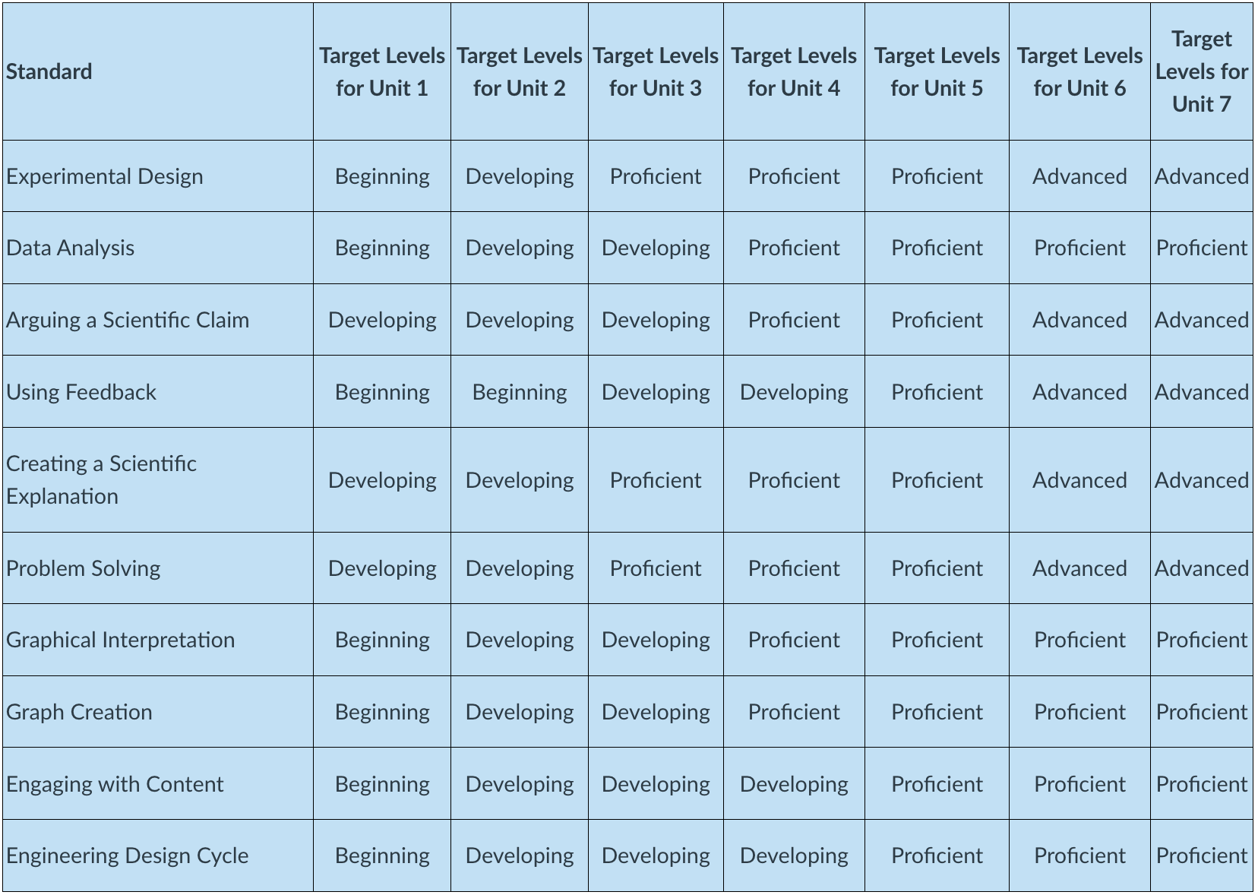
Making a Plan for Progress

Slide 25
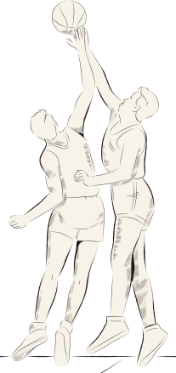
Assessment & Feedback
Types of Assessment
Practice vs. Scrimmage vs. Game
Descriptive Feedback
Reassessment

Slide 26
"Assessment should not be separate from teaching. It should be an integral part of teaching, providing evidence of what is and isn't working.“
Dylan Wiliam, 2011
© 2023 by Elise Naramore
Notes:
Tons of research that confirms the effectiveness of reflective practice. While this quote is from nearly 30 years ago, it has been validated over and over again.

Slide 27
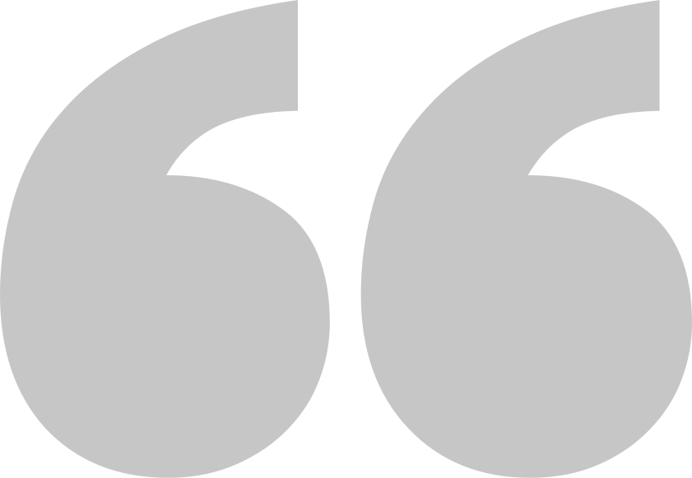
Ideally, we would not have to give grades at all.
Reporting Progress
But, since we do... how do we fit LPM into a traditional grades school?

Slide 28
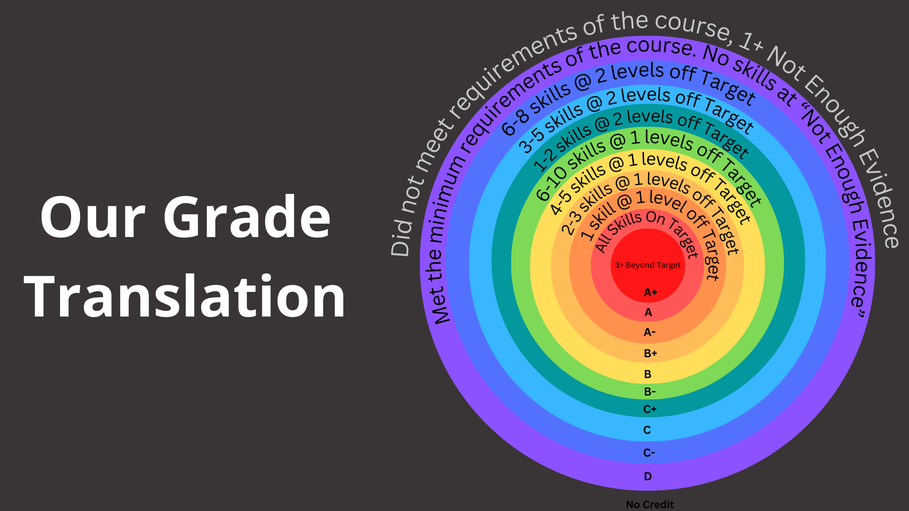

Slide 29
Benefits of Using the Grade Translation in combination with Target Levels
1
2
3
Customize Target Levels, not Grades
Focus on Growth over Time
The Same All Year, for All Classes
Notes:
Let’s imagine there is a student who earned Beginning in all 10 skills in Unit 1. They would have 3 skills only 1 level below target at that point, which is equivalent to a B+.
If that student earned Beginning in all 10 skills in Unit 2, they would have 9 skills that are 1 level below target by that point, which is equivalent to a B-.
If that student earned Beginning in all 10 skills in Unit 3, they would have 2 skills that are 2 levels below target by that point, which is equivalent to a C+.
If students do not show growth, their grade will decrease systematically over time. This is so easy. It is also logical!

Slide 33
Reflection is a form of retrieval practice (What happened? What did I do? How did it work out?), enhanced with elaboration (What would I do differently next time?)
Peter Brown, 2014

Slide 34
Student Reflection
Teacher Reflection
identify strengths and weaknesses
adapt learning strategies to better meet their own needs
learn from mistakes and understand that learning is a process.
identify strengths and weaknesses
adapt teaching strategies to better meet the needs of students
promote a growth mindset in the classroom.
Notes:
Student:
1) journaling (private or shared)
2) surveys
3) goal setting
4) asking for support
5) "using feedback"
6) conferencing
7) annotating/correcting work
Teacher:
1) results of assessment
2) results of surveys
3) intuition
4) conversations with students

Slide 35
Learning Progession: "Using Feedback"
The goal is to highlight the changes you made from the previous lab. The goal is to communicate what changes you made, why you made them, and how you have improved over time.
Not Enough Evidence | Beginning | Developing | Proficient | Advanced | Expert
I did not identify changes that I made since the previous lab report. | I identify changes that I made since the previous lab report. | I describe at least 6 changes that I made since the previous lab report, correlated to feedback from my peers, the instructor, class discussion, or my own understanding of this rubric. | I explicitly state why changes needed to be made (or not made) based on relevant physics or skills requirements. | I correctly and appropriately make changes based upon the feedback received, or correctly state why I chose not to do so. In addition, I request specific feedback from the instructor, identifying areas with which I am uncertain or struggling. | I communicate and document the rationale behind alternate approaches to similar (but not identical) situations, based on feedback received prior to the current attempt. I communicate areas of weakness and document the methodical application of strategies that I used to improve.
© 2023 by Elise Naramore

Slide 36
Conferencing
Formal
Informal
Notes:
Formal -
3x
preparation (goal setting, score tracking, reflection)
5-10 min, outside of class
Informal -
indiv or sm group
during or outside of class
homo or heterogeneous
mandatory or by invitation
Parent -
proactive or reactive
email or phone or f2f

Slide 37
Four Things You Can Do Tomorrow
1. Change Language
2. Transparent Communication
3. Using Feedback
4. Reflective Practices

Slide 38
Language
“When we label people, we are limiting our expectations of them. Labels are judgments, not facts.”
C. Dweck, 2017
Notes:
When we use labels to describe students, we can unintentionally limit our expectations of them. This can create pressure and anxiety for students, whether they typically earn high or low grades. In fact, students who are labeled as high achievers can experience pressure to maintain that label, leading to anxiety and fear of failure (Schussler, 2020). What do labels sound like?
She’s an “A-student”
He’s a “Special Ed Student” -> student who has an IEP
She’s a “Trouble Maker” -> Student who is acting out
He’s not a “math-person”.
As Carol Dweck, a leading expert on motivation and learning, explains, "When we label people, we are limiting our expectations of them. Labels are judgments, not facts" (Dweck, 2017).Therefore, it is important for teachers to avoid labeling students and instead focus on their strengths and potential for growth. It’s a simple matter of choosing our words wisely. For example: Instead of “She’s an A-student”, we can say “a student who is demonstrating success” or "a student who is currently earning an A.” Instead of “He’s a Special Ed Student”, we can say “a student who has an IEP’.
We are not merely trying to be politically correct here. This is a matter of open up our minds to see people as more three dimensional, with characteristics beyond this one attribute. By reframing our language and avoiding labels, we can create a more positive and inclusive learning environment for all students.

Slide 39
Communication
“Transparency can create a sense of trust between teachers and students, which is essential for creating a positive learning environment.”
D. Wiliam, 2019
© 2023 by Elise Naramore
Notes:
Transparent communication can help students understand why you are using certain assessment strategies and how they can use feedback to improve their learning. According to a study by Anderman and Anderman (2018), "when teachers communicate the purpose of feedback, provide students with clear and specific criteria for success, and involve them in the feedback process, students are more likely to engage with and use feedback to improve their learning" (p. 67).
By explaining the rationale behind assessments and providing students with clear feedback, we can help them understand how they are progressing towards their learning goals. "Transparency can create a sense of trust between teachers and students, which is essential for creating a positive learning environment" (Wiliam, 2019). When students understand the purpose of assessments and how they can use feedback to improve, they are more likely to engage in the learning process.
Explain why you are doing each activity or lesson. Not just the essential question, or course objectives, but what you hope they will get as a result of doing it in this particular manner. I tell the students overtly that I want them to understand my rationale, that I don’t do anything to fill time, and that I want to know what is (or is not) useful. Taking the time to explain my thinking helps to model clear communication, respects their role as recipients of my plans, and hopefully, engages them in the direction that I have intended. They know why I am assigning X, so hopefully they will seek that result.

Slide 40
Using Feedback
Feedback is most powerful when it is used by the student to adjust their own learning strategies.
Black & Wiliam, 2018
© 2023 by Elise Naramore
Notes:
Using a "Using Feedback" rubric can encourage students to engage with feedback and reflect on their learning. According to research by Black and Wiliam (2018), "feedback is most effective when it is focused on specific goals and criteria, and when students are given opportunities to respond to feedback and use it to improve their learning" (p. 24). By using a feedback rubric, you can help students understand what they need to do to improve their performance and provide them with opportunities to reflect on their learning.
Incorporating feedback rubrics into assessments can encourage students to reflect on their learning and take ownership of their progress (Black & Wiliam, 2018). When students are given specific feedback on their work and encouraged to respond to it, they can develop metacognitive skills and a growth mindset.
As Paul Black and Dylan Wiliam note, "Feedback is most powerful when it is used by the student to adjust their own learning strategies" (Black & Wiliam, 2018). By providing students with clear feedback rubrics and encouraging them to use feedback to improve their work, teachers can help students become more engaged and invested in their learning.

Slide 41
Reflective Practice
Reflective practices can help students develop a sense of agency and responsibility for their own learning.
Jossey-Bass, 2021
© 2023 by Elise Naramore
Notes:
Incorporating reflective practices such as journaling or conferencing can help students develop metacognitive skills and become more self-aware of their learning (Barkley, Cross, & Major, 2014). By reflecting on their learning experiences and setting goals for future learning, students can take ownership of their learning and become more engaged in the process.
As Jossey-Bass notes, "Reflective practices can help students develop a sense of agency and responsibility for their own learning" (Jossey-Bass, 2021). By incorporating reflective practices into assessment strategies, teachers can encourage students to become more reflective and active learners.
Reflective practices, such as journaling or conferencing, can help students develop metacognitive skills and become more self-aware learners. According to Schön (1983), "reflection is a key component of metacognition, as it involves thinking about one's own thinking and learning processes" (p. 68). By incorporating reflective practices into your assessment strategies, you can help students develop a deeper understanding of their own learning and become more effective learners.

Slide 42
Final Thoughts
Takeaway #1:
If the skill is valuable to us (and our students), we must provide instruction, provide feedback, and give further opportunities to practice.
Takeaway #2: Communication is the key to any good relationship! Talk to your colleagues, connect to others walking this path, converse with students about their goals, etc.
© 2023 by Elise Naramore
Notes:
Assessment 3.0, or the Learning Progression model, offers a significant improvement over traditional grading and Standards-Based Grading. By focusing on improvement over time, emphasizing learning as a process, and fostering positive teacher-student relationships, this model ensures that students receive meaningful feedback that helps them grow and succeed. Moreover, by removing non-academic factors from grading, this model promotes fairness and equity, helping students from all backgrounds reach their full potential. Finally, by encouraging reflective practice, the Learning Progression model promotes a growth mindset that will serve students well throughout their lives. We encourage educators to adopt this model and help us move towards a better educational experience for all students.

Slide 43
Learn more about LPM at our other presentations at NSTA 2023:
Thursday 9:45 - 10:45 AM GWCC - A405
Thursday 1:00 - 2:00 PM GWCC - B312
Friday 4:00 - 5:00 PM GWCC - B303
Saturday 12:00 - 1:00 PM GWCC - Exhibit Hall
Saturday 1:20 - 2:20 PM GWCC - A301
Saturday 2:40 - 3:40 PM GWCC - A311
Supporting Equitable Classroom Practices Through Alternate Assessment
Assessment 3.0
Using Feedback
Content is the Vehicle, Not the Destination
A Practice vs. Practice
Ditch Grades Not Accountability

Slide 44
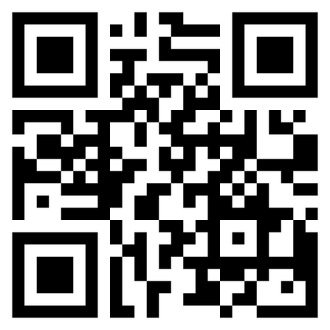
Elise Naramore
Thank you!
reimaginedschools.com

