Slide 1
A Practice vs. Practice
@DavidFrangiosa
Pascack Hills HS
Montvale, NJ

Slide 2
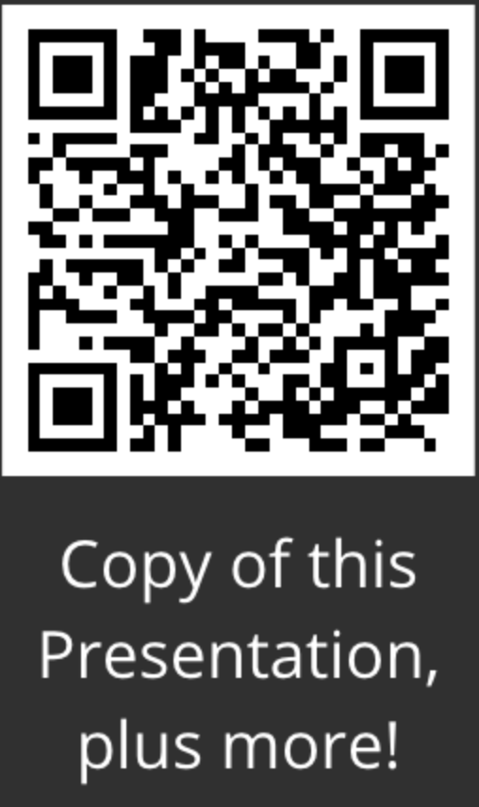
A Practice vs. Practice
@DavidFrangiosa
Pascack Hills HS
Montvale, NJ

Slide 3
Session Goals
We will understand the roles of guided and independent practice, when to use each, and a system for supporting students as they engage with the science and engineering practices.
Takeaways
Develop language to communicate classroom expectations
Understand how to set targeted level of development for each skill
Understand the role of practice in developing these skills

Slide 4
SEPs
1. Asking questions (for science) and defining problems (for engineering)
2. Developing and using models
3. Planning and carrying out investigations
4. Analyzing and interpreting data
5. Using mathematics and computational thinking
6. Constructing explanations (for science) and designing solutions (for engineering)
7. Engaging in argument from evidence
8. Obtaining, evaluating, and communicating information

Slide 5
Aligning the Practices with Progressions
Learning Progressions | NGSS Practices
Experimental Design | Asking questions and defining problems
Problem Solving | Developing and using models
Data Analysis | Planning and carrying out investigations
Arguing a Scientific Claim | Analyzing and interpreting data
The Engineering Design Process | Using mathematics and computational thinking
Using and Providing Feedback | Constructing explanations and Designing solutions
Graph Interpretation | Engaging in Argument from Evidence
Graph Creation | Obtaining, evaluating, and communicating information
Creating Explanations and Making Predictions

Slide 6
Aligning the Practices with Progressions
Learning Progressions | NGSS Practices
Experimental Design | Asking questions and defining problems
Problem Solving | Developing and using models
Data Analysis | Planning and carrying out investigations
Arguing a Scientific Claim | Analyzing and interpreting data
The Engineering Design Process | Using mathematics and computational thinking
Using and Providing Feedback | Constructing explanations and Designing solutions
Graph Interpretation | Engaging in Argument from Evidence
Graph Creation | Obtaining, evaluating, and communicating information
Creating Explanations and Making Predictions

Slide 7
Create Aligned Assessments
 | Quizzes | Tests | Projects | Labs | Presentations | Problem Sets
Experimental Design
Problem Solving
Data Analysis
Arguing a Scientific Claim
Engineering Design
Creating and Interpreting Graphs
Using and Providing Feedback
Creating Explanations
Making Predictions
Notes:
Once your learning progressions are created, you need to figure out what assessments to use. When you look closely at your assessments, you will probably end up identifying broad categories. Ideally, you want to use the same rubric for every assessment in a category. This streamlines your grading as well as increasing student progress.
Here’s how we figured it out: across the top were all of the types of assessments that we did. (We didn’t rewrite our entire course! That would be a daunting task, and is completely unnecessary.)
Down the left are the learning progressions we designed (NOTE: they didn’t all fit on this slide). We completed the matrix, with the stars representing which types of assignments could be assessed with each Learning Progression. Then we chose ONE single category of assessment for each LP. So our rubric for a quiz/test includes Problem Solving, Creating Explanations, and Creating and Interpreting Graphs. Our rubric for Labs includes Exp Dsgn, Data Analysis, Arguing a Claim, and Using Feedback. Note that on Labs, we could have but don’t directly assess Creating Explanations or Graphing because we know we do this on the Tests. This works GREAT! Limits our time and focuses attention on a small handful of tasks at a time. Plus, there is inevitably some overlap between the Learning Progressions. For example, Arguing a Claim has similarities with Creating Explanations, but we use one for labs and the other for tests.

Slide 8
Finding a Natural Fit
Lab Skills
Experimental Design
Data Analysis
Arguing a Scientific Claim
Using and Providing Feedback
Projects
The Engineering Design Process
Checkpoints
Problem Solving
Graph Interpretation
Graph Creation
Creating Explanations and Making Predictions

Slide 9
Creating Target Levels for Learning Progressions
Try - Students try to complete the assigned task.
Explain - Students use relevant content knowledge to try to address the task. (The content knowledge does not have to be correct, but it must be reasonable.)
Explicit - Students explicitly and accurately state a relevant big idea, equation, law, etc., but the application is incorrect or incomplete.
Correct - Students explicitly and accurately state a relevant big idea, equation, law, etc. and apply it correctly and completely.
Complete/Complex - Students explicitly and accurately address a complex task that includes multiple steps or concepts.

Slide 10
Arguing a Scientific Claim Progression
 | Not Enough Evidence | Beginning | Developing | Proficient | Advanced | Expert
Arguing a Scientific Claim | I did not write a conclusion. | I write a conclusion. | I present a scientific claim regarding the relationship between relevant dependent and independent variables. I present evidence obtained from my investigations as support. | I present a scientific claim that accurately describes the relationship derived from my experimental results. I present convincing evidence. I state a physics concept, theory, or equation as reasoning. | I present the most convincing, valid and reliable evidence obtained from my investigations as support for my claim. I clearly state a relevant physics concept, theory, or equation as reasoning. The reasoning is clearly related to the variables in the claim. There is no extra/irrelevant information. | I effectively tie physics theory correctly, directly, and tightly to the most sophisticated supporting evidence available, so that my claim is clearly justified. I justify my claim by providing quantitative proof that the results reflect the theory.

Slide 11
Identifying Targeted Levels of Development
Learning Progressions | Unit 1 | Unit 2 | Unit 3 | Unit 4 | Unit 5 | Unit 6
Experimental Design | Beginning | Developing | Developing | Proficient | Proficient | Proficient
Data Analysis | Beginning | Developing | Developing | Proficient | Proficient | Proficient
Arguing a Claim | Developing | Developing | Developing | Proficient | Proficient | Advanced
Creating Explanations | Developing | Developing | Proficient | Proficient | Proficient | Advanced
Problem Solving | Developing | Developing | Proficient | Proficient | Advanced | Advanced
Graph Interpretation | Beginning | Beginning | Developing | Developing | Proficient | Proficient

Slide 12
Arguing a Scientific Claim Progression
 | Not Enough Evidence | Beginning | Developing | Proficient | Advanced | Expert
Arguing a Scientific Claim | I did not write a conclusion. | I write a conclusion. | I present a scientific claim regarding the relationship between relevant dependent and independent variables. I present evidence obtained from my investigations as support. | I present a scientific claim that accurately describes the relationship derived from my experimental results. I present convincing evidence. I state a physics concept, theory, or equation as reasoning. | I present the most convincing, valid and reliable evidence obtained from my investigations as support for my claim. I clearly state a relevant physics concept, theory, or equation as reasoning. The reasoning is clearly related to the variables in the claim. There is no extra/irrelevant information. | I effectively tie physics theory correctly, directly, and tightly to the most sophisticated supporting evidence available, so that my claim is clearly justified. I justify my claim by providing quantitative proof that the results reflect the theory.

Slide 13
Arguing a Scientific Claim Progression
 | Not Enough Evidence | Beginning | Developing | Proficient | Advanced | Expert
Arguing a Scientific Claim | I did not write a conclusion. | I write a conclusion. | I present a scientific claim regarding the relationship between relevant dependent and independent variables. I present evidence obtained from my investigations as support. | I present a scientific claim that accurately describes the relationship derived from my experimental results. I present convincing evidence. I state a physics concept, theory, or equation as reasoning. | I present the most convincing, valid and reliable evidence obtained from my investigations as support for my claim. I clearly state a relevant physics concept, theory, or equation as reasoning. The reasoning is clearly related to the variables in the claim. There is no extra/irrelevant information. | I effectively tie physics theory correctly, directly, and tightly to the most sophisticated supporting evidence available, so that my claim is clearly justified. I justify my claim by providing quantitative proof that the results reflect the theory.

Slide 14
Arguing a Scientific Claim Progression
 | Not Enough Evidence | Beginning | Developing | Proficient | Advanced | Expert
Arguing a Scientific Claim | I did not write a conclusion. | I write a conclusion. | I present a scientific claim regarding the relationship between relevant dependent and independent variables. I present evidence obtained from my investigations as support. | I present a scientific claim that accurately describes the relationship derived from my experimental results. I present convincing evidence. I state a physics concept, theory, or equation as reasoning. | I present the most convincing, valid and reliable evidence obtained from my investigations as support for my claim. I clearly state a relevant physics concept, theory, or equation as reasoning. The reasoning is clearly related to the variables in the claim. There is no extra/irrelevant information. | I effectively tie physics theory correctly, directly, and tightly to the most sophisticated supporting evidence available, so that my claim is clearly justified. I justify my claim by providing quantitative proof that the results reflect the theory.

Slide 15
Types of Practice
The setting for practice is irrelevant
Guided practice - done with assistance
Teacher directed
Video guide
Independent practice
Students work individually or in small groups
Teacher circulates and supports as necessary

Slide 16
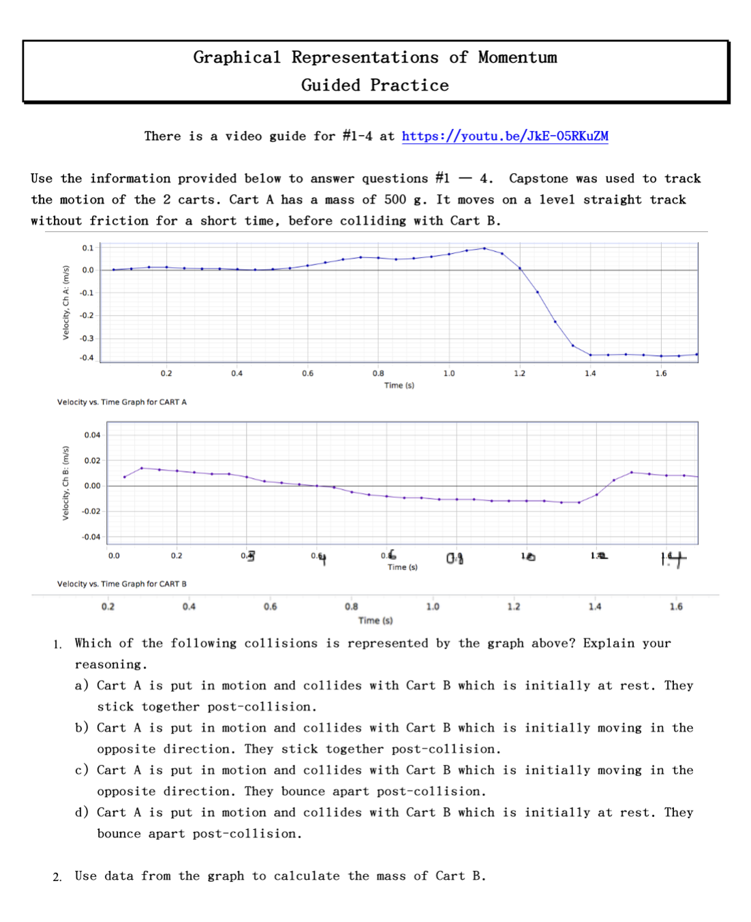
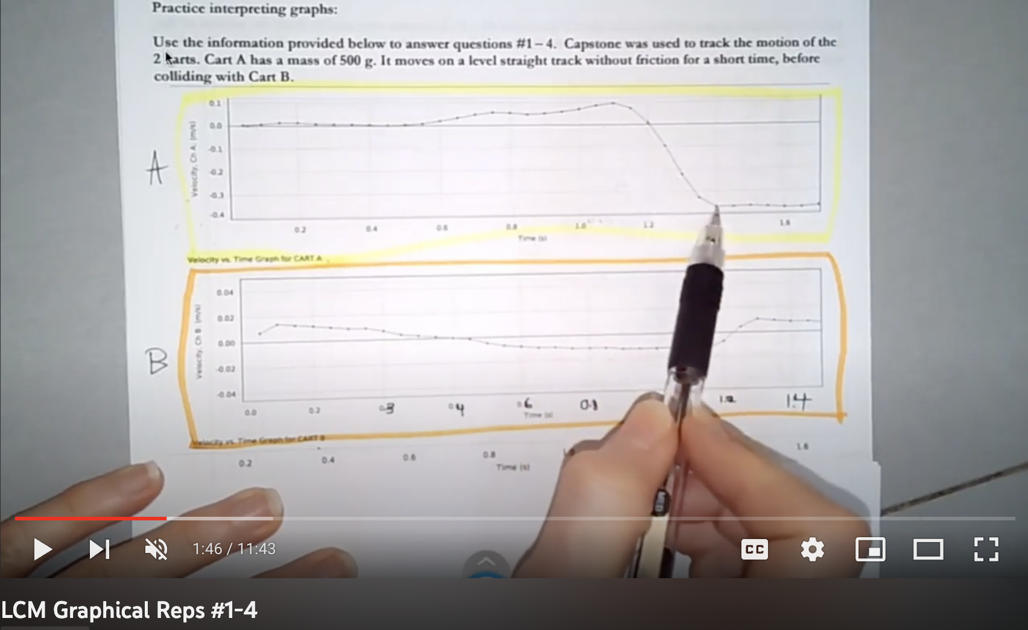
A sample workflow
Guided practice

Slide 17
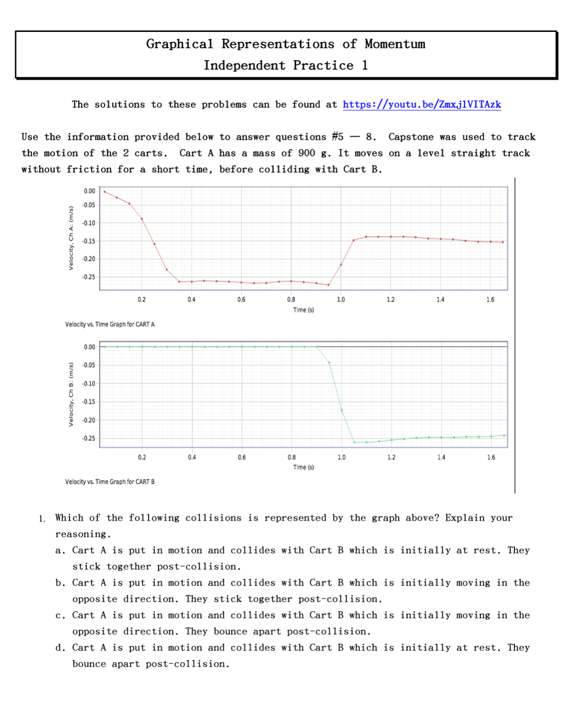
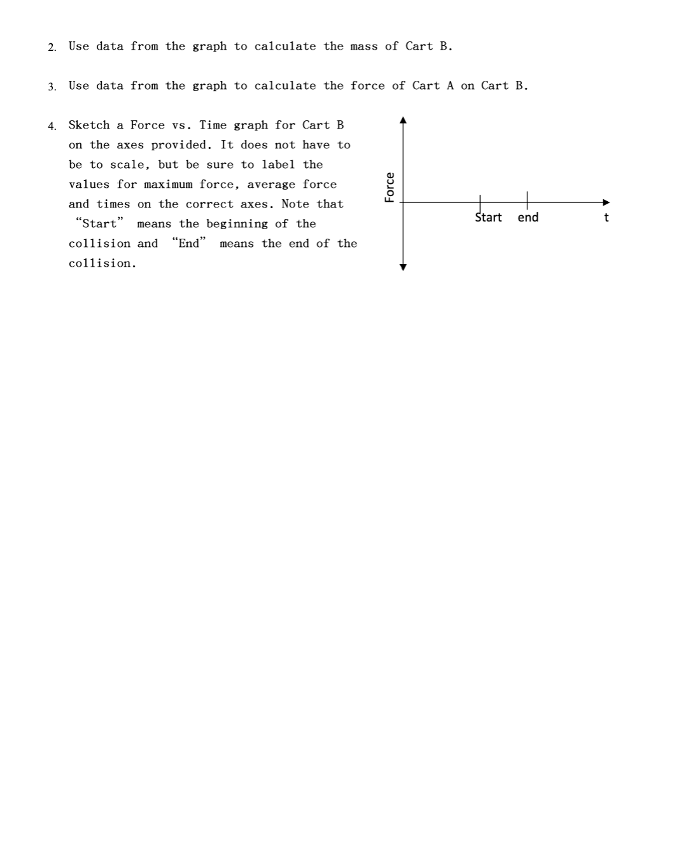
A sample workflow
Guided practice
Independent practice.

Slide 18
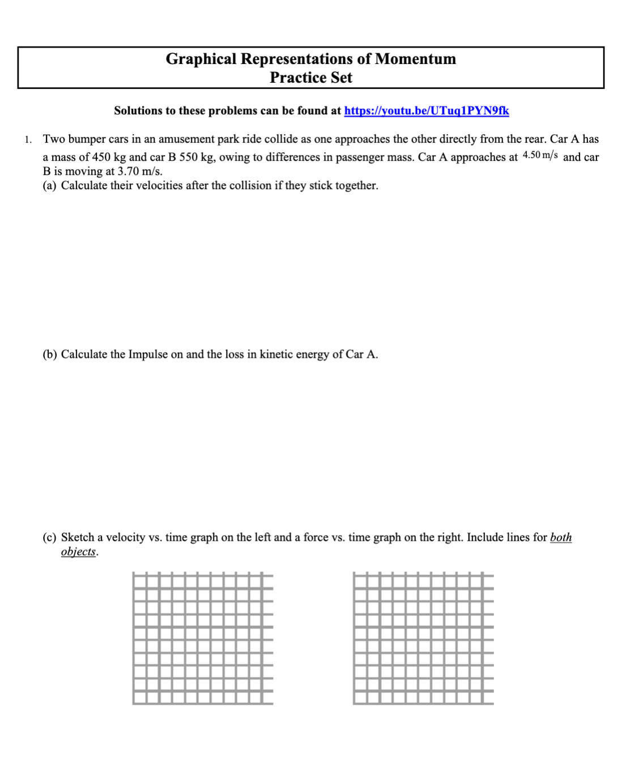
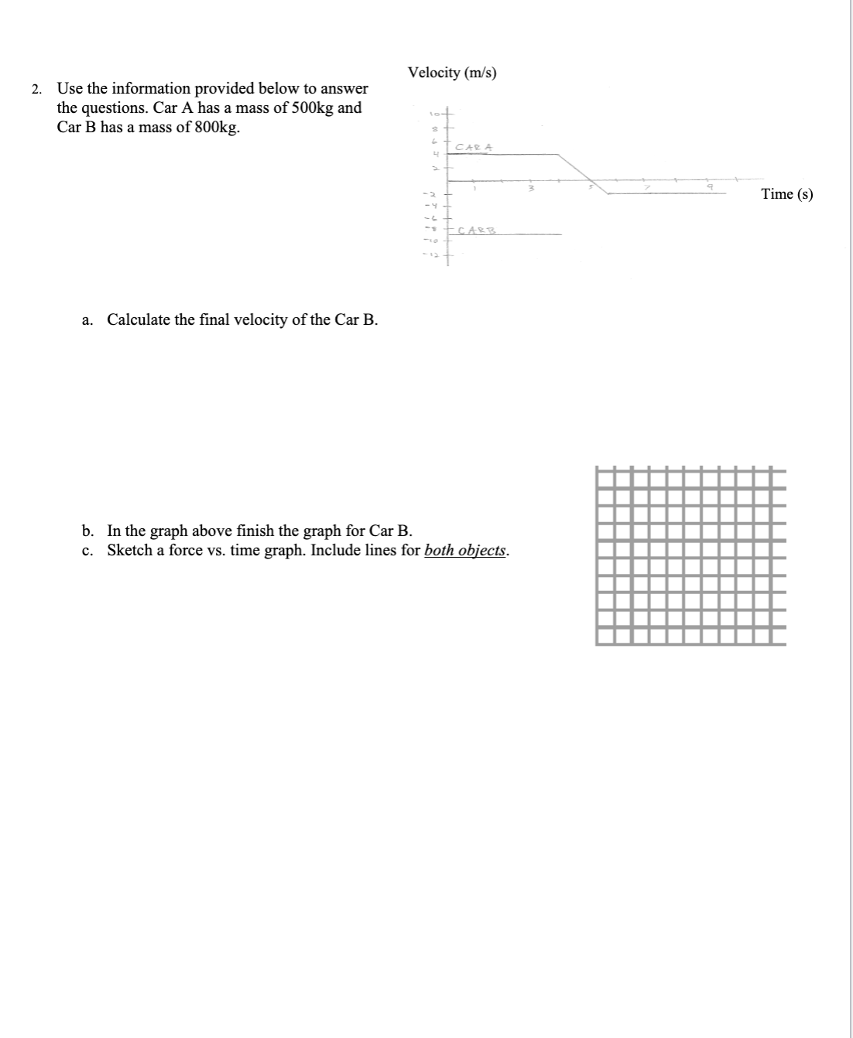
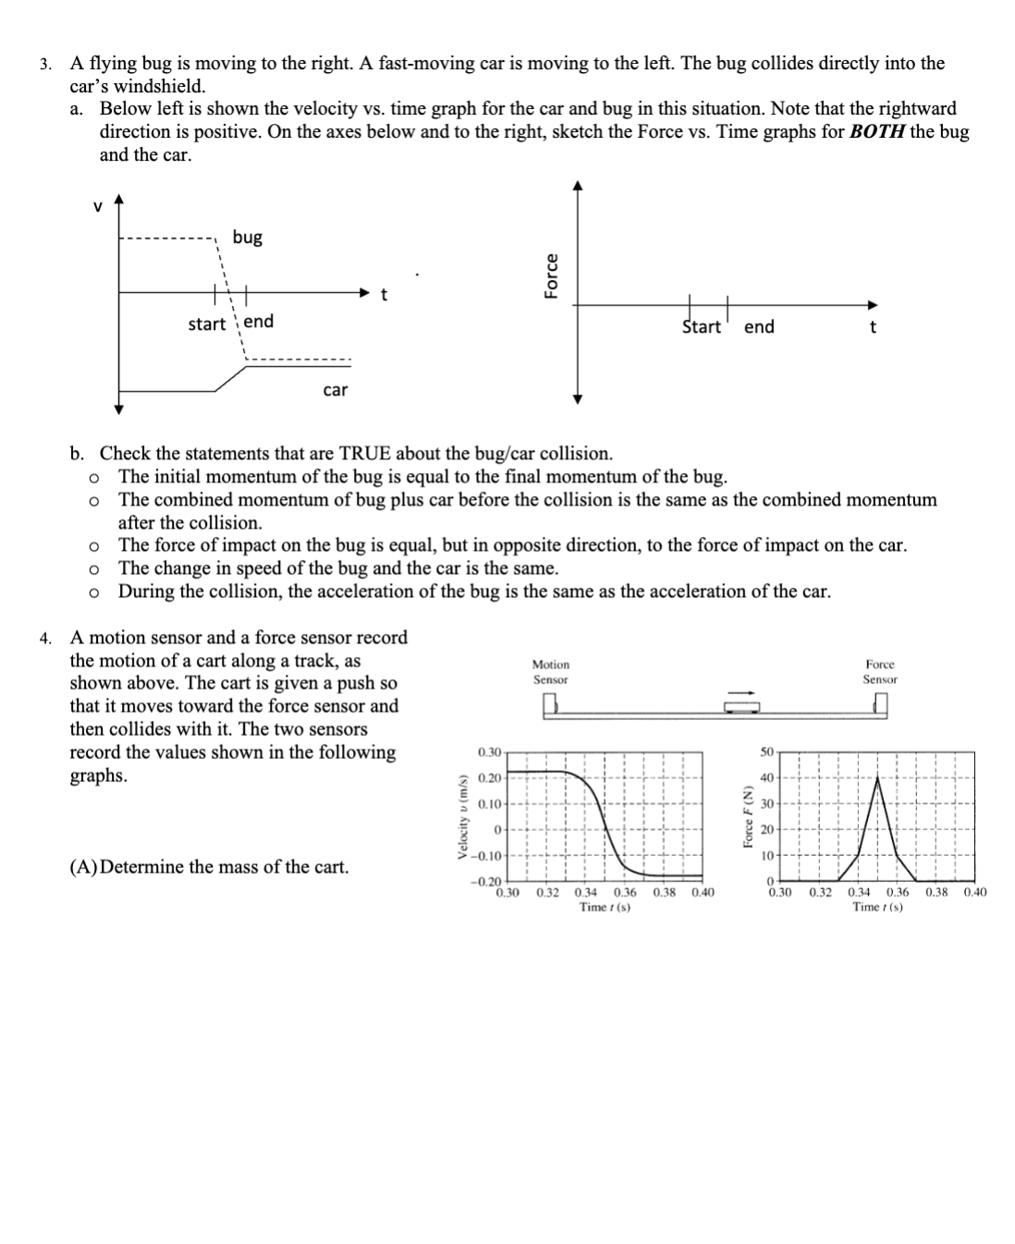
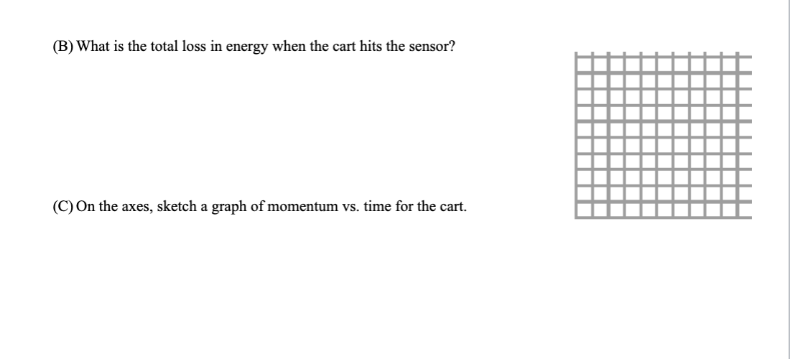
A sample workflow
Guided practice
Independent practice
Practice set

Slide 19
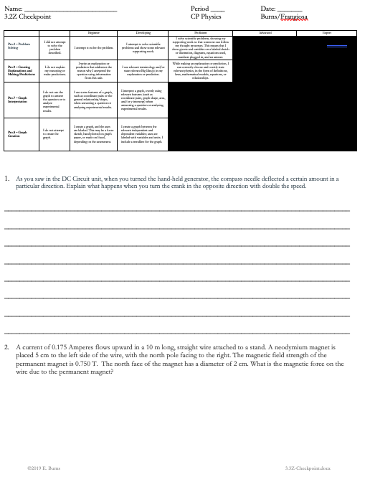
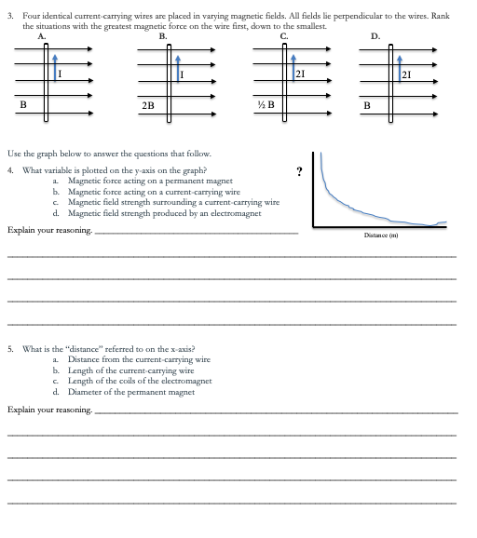
A sample workflow
Guided practice
Independent practice
Practice set
Checkpoint

Slide 20
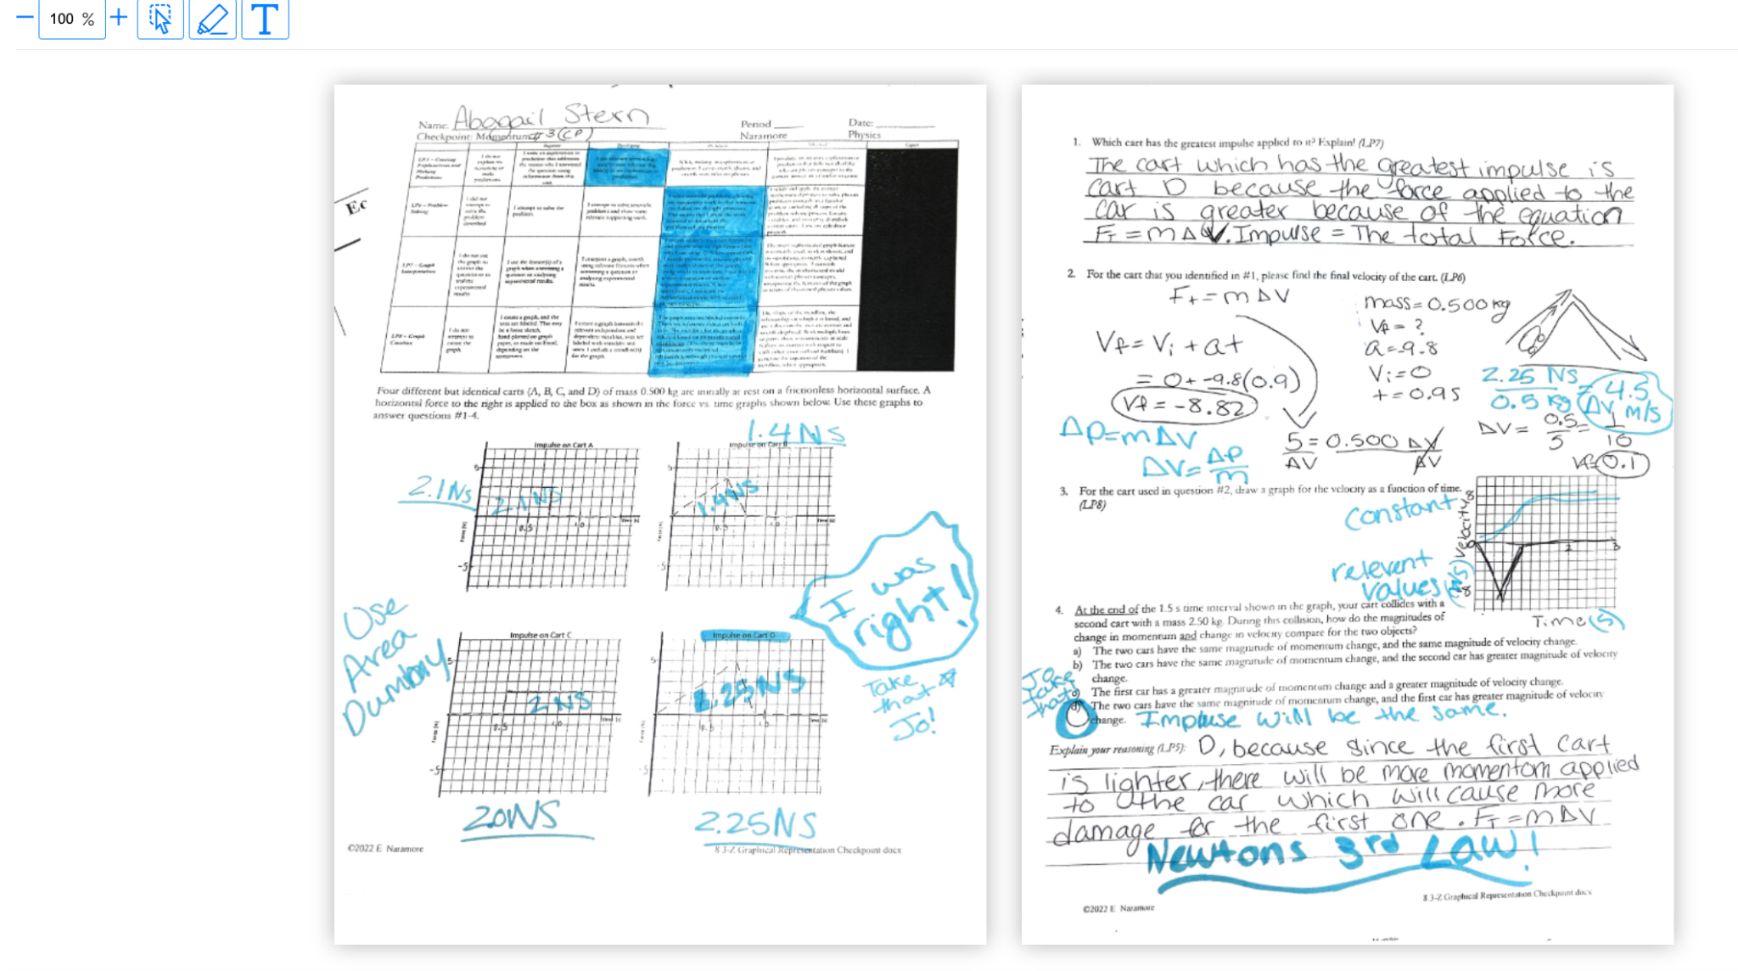
A sample workflow
Guided practice
Independent practice
Practice set
Checkpoint
Go over checkpoint
Done in different color
Students make corrections as we review
Provides immediate feedback
Self-assess

Slide 21
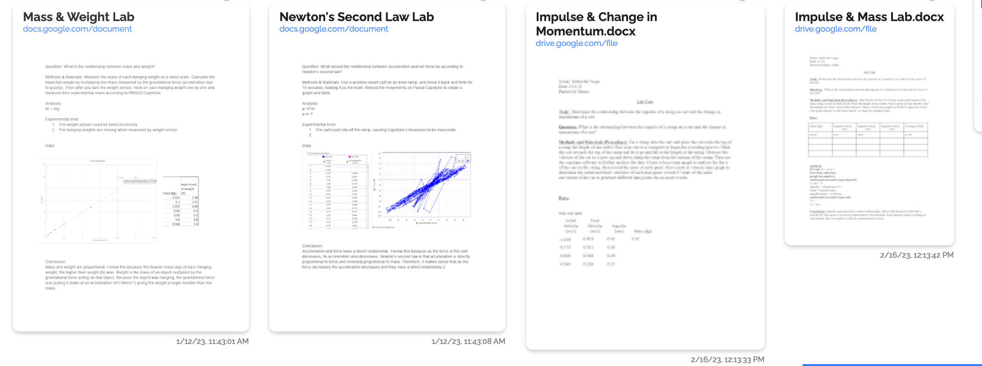
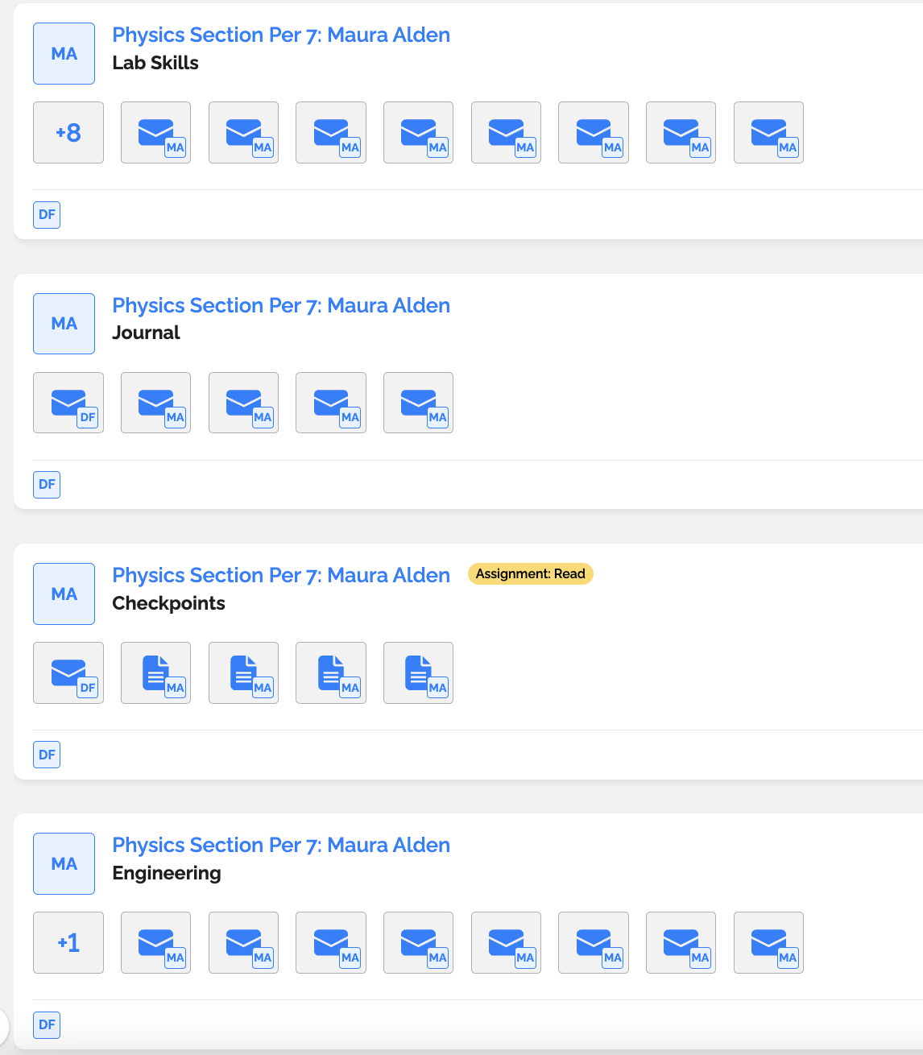
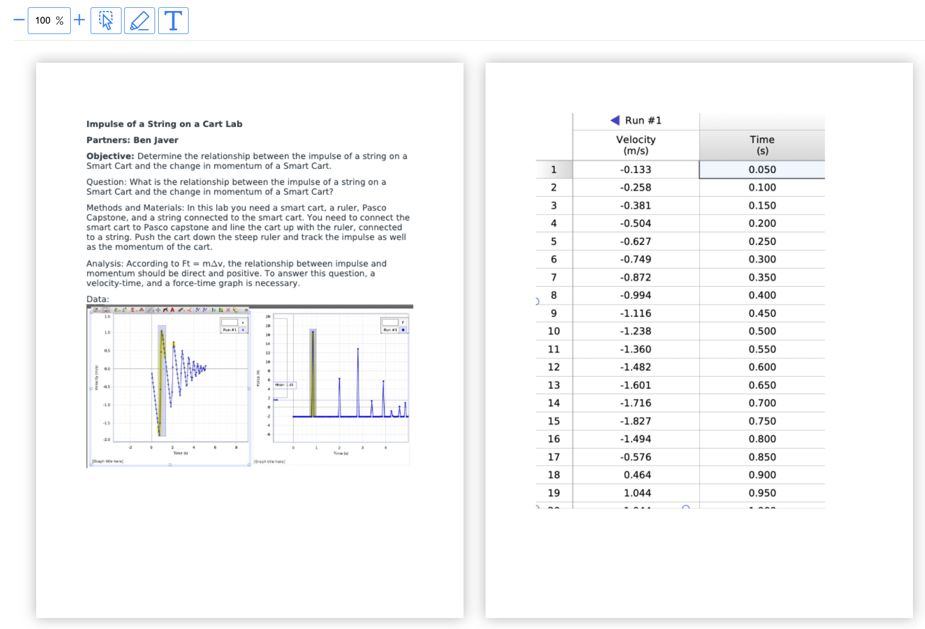
A sample workflow
Guided practice
Independent practice
Practice set
Checkpoint
Go over checkpoint
Update gotLearning (e-portfolio)

Slide 22
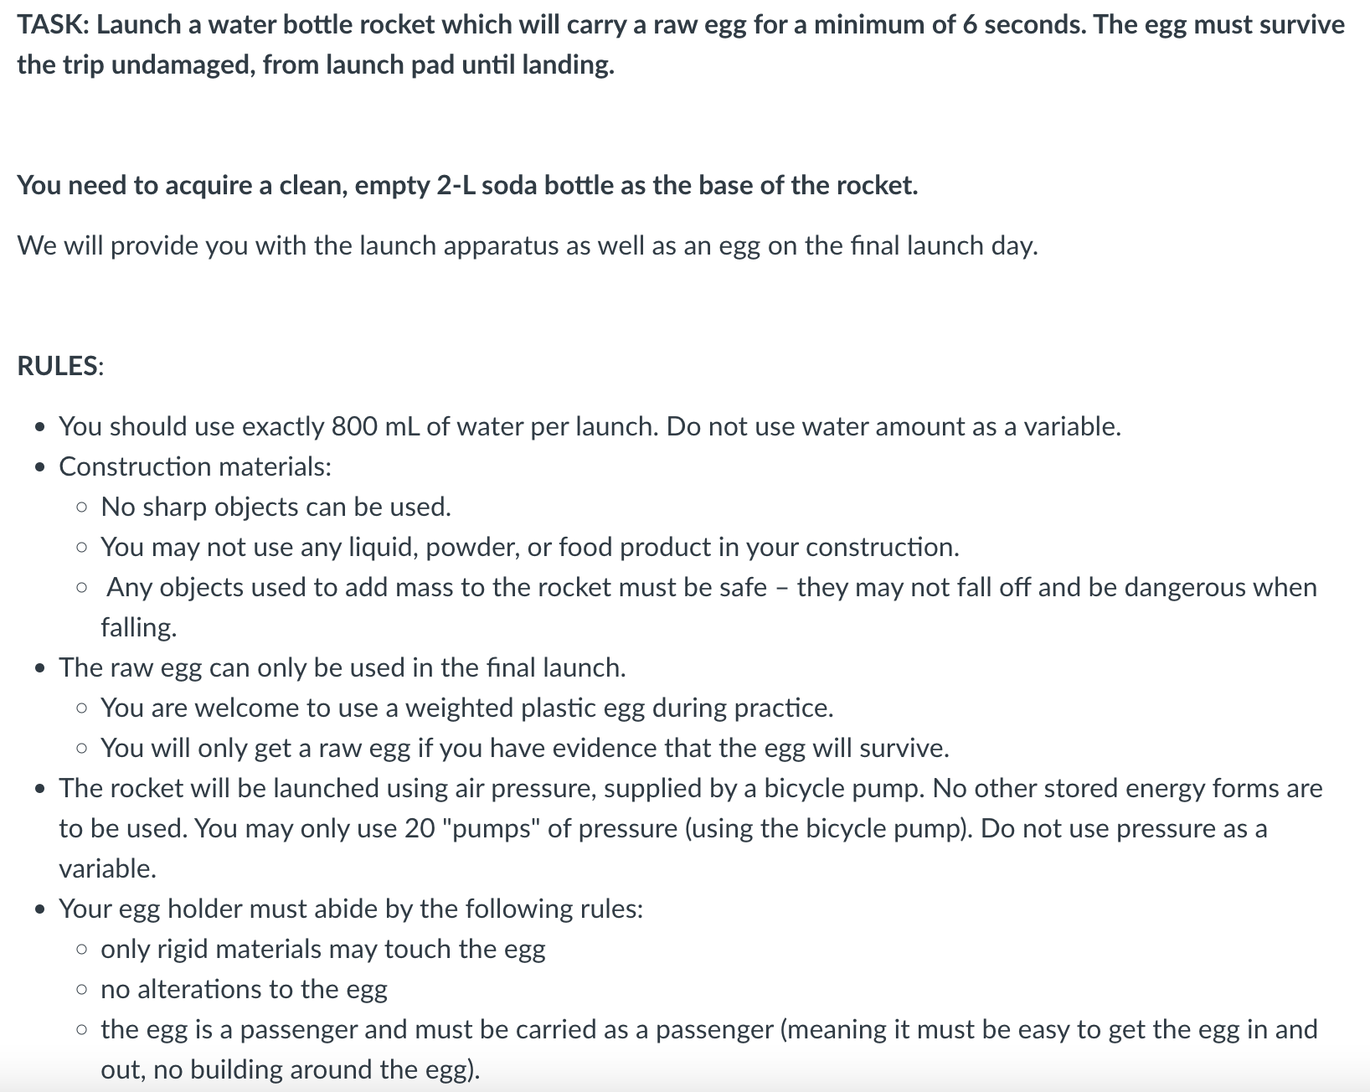
A sample workflow
Guided practice
Independent practice
Practice set
Checkpoint
Go over checkpoint
Update gotLearning (e-portfolio)
Mini-conference and/or project work.

Slide 23
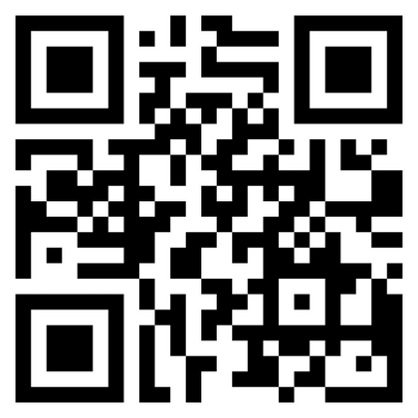
Contact Us
@DavidFrangiosa
dfrangiosa@pascack.org
Link to our website with more information

